Slide 1
MICROPLASTICS

Slide 2
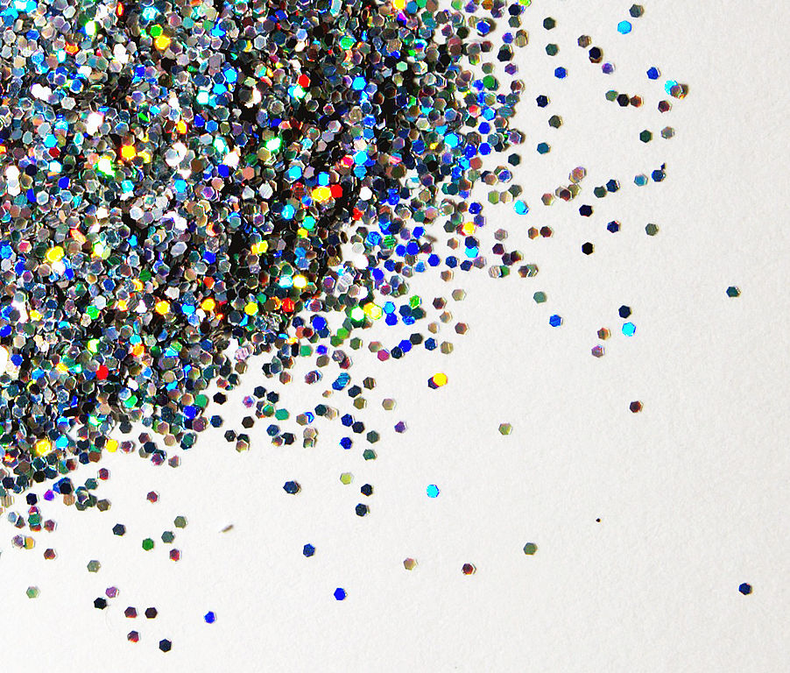
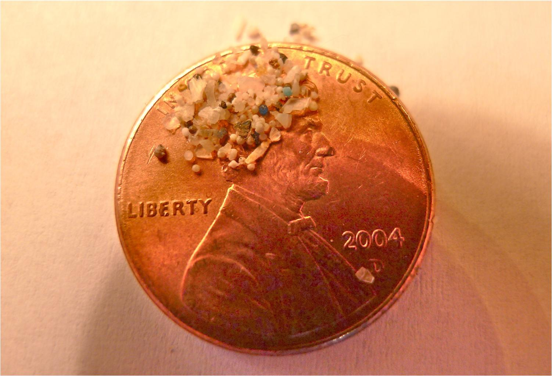
WHAT ARE MICROPLASTICS?
Tiny plastic particles
1 mm - 5 mm wide
Too small to be filtered in water treatment facility
Two types of microplastics:
Primary: enter waterway as small pieces
Secondary: enter waterways in larger pieces but break down into smaller ones

Slide 3
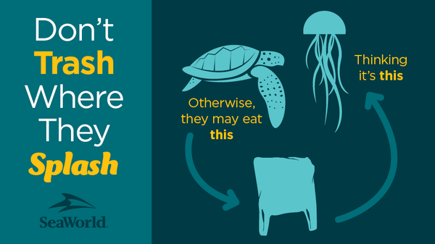
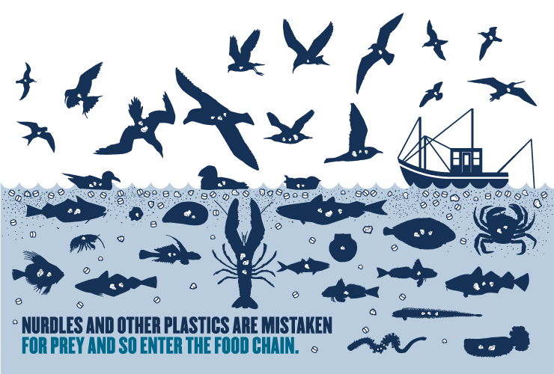
ENVIRONMENTAL RISK TO AQUATIC LIFE
Microplastics accumulate in water and reside there for a long time
Account for 10% of litter on beaches
Fish mistake them for plankton, eating them mistakenly
Cannot digest microplastics
Microplastics remain in stomach
Leads to malnourishment and eventually death
Microplastics ingested by many other aquatic organisms
Waterfowl, crustaceans, reptiles, etc.

Slide 4
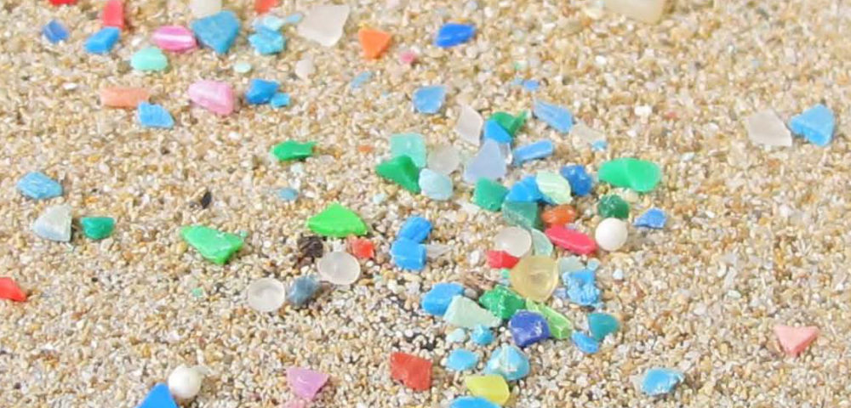
ENVIRONMENTAL RISK TO AQUATIC ECOSYSTEMS
Some microplastics are buoyant
Mimic insects on water surface
Some microplastics sink
Impacts to bottom feeding species
Plastic debris can transport different organisms outside their natural habitats
Causes spread of invasive species
Causes loss of biodiversity

Slide 5
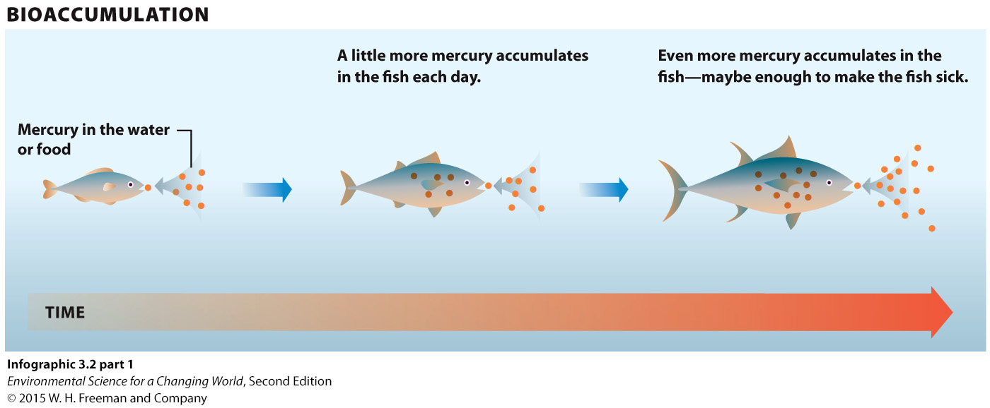
CHEMICAL RISKS
Microplastics are exposed to UV rays when in the environment
Causes release of harmful chemicals not normally found in nature
BPA: common component in food containers
Can have negative affects on fetal development and adult hormone levels
Carcinogenic: cancer causing substance

Slide 6
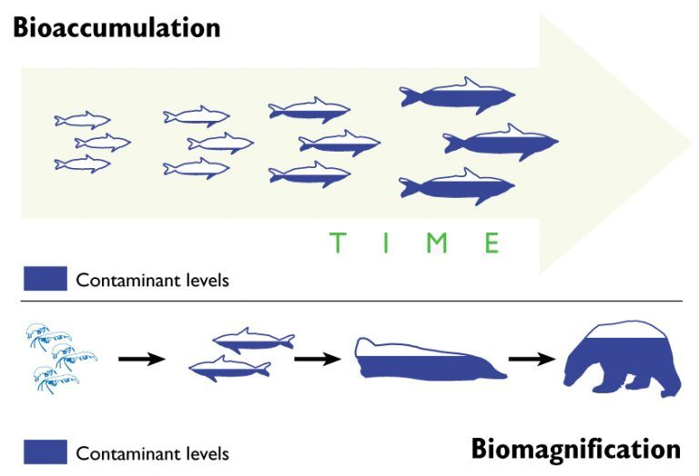
CHEMICAL RISKS
POPs: Persistent Organic Pollutants
Organic compounds resistant to environmental degradation (do not deteriorate)
Biomagnification: the buildup of pollutants as they move up the food chain
Bioaccumulation: the buildup of pollutants in individual organisms over time
Harmful chemicals in water may attach to surface of microplastics
Photo Credit: www.mercurypolicy.scripts.mit.edu

Slide 7
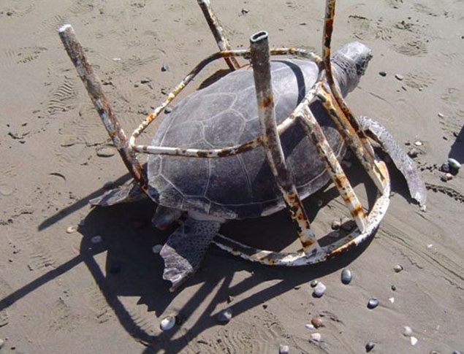
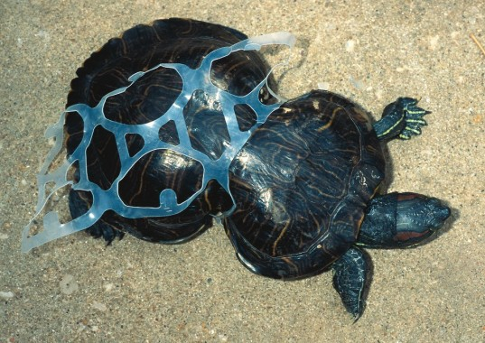
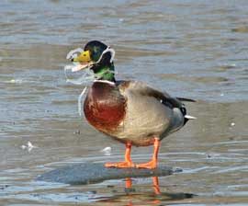
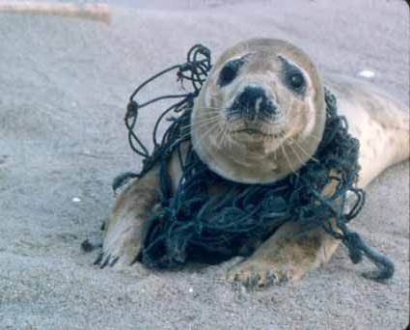
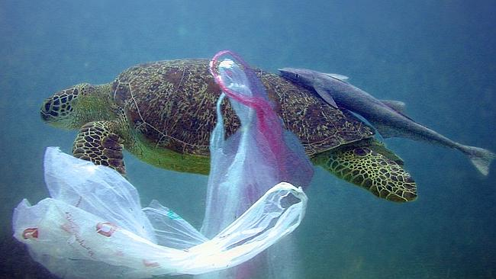
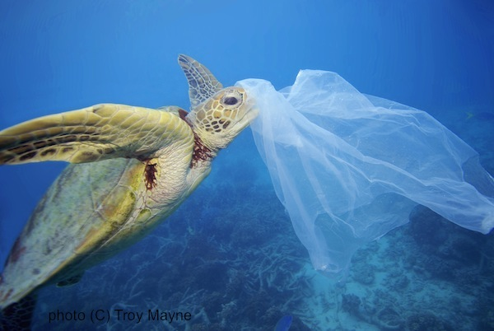

Slide 8
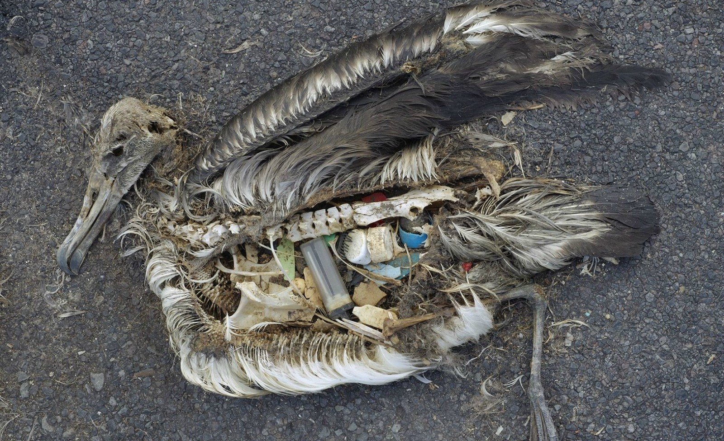
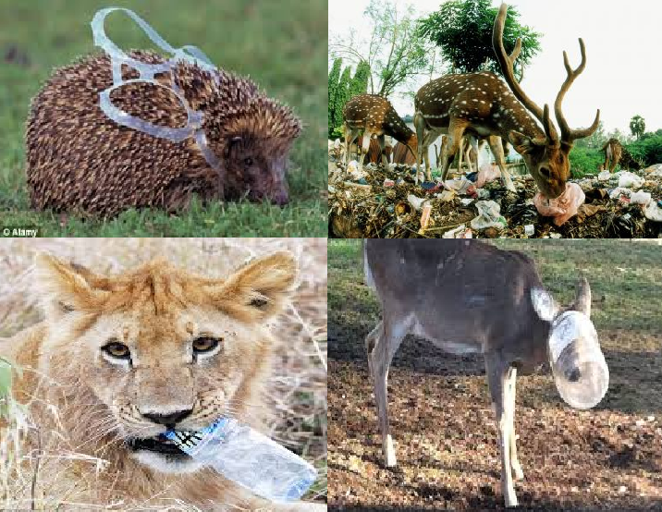
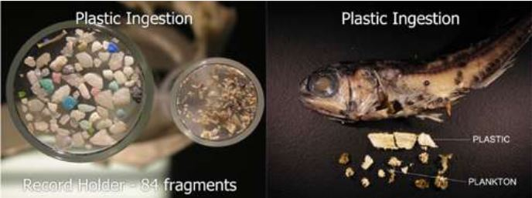
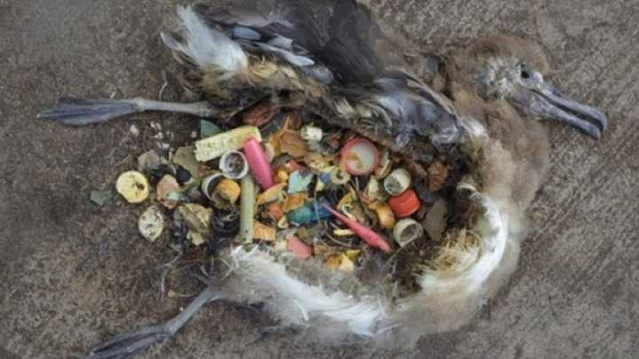
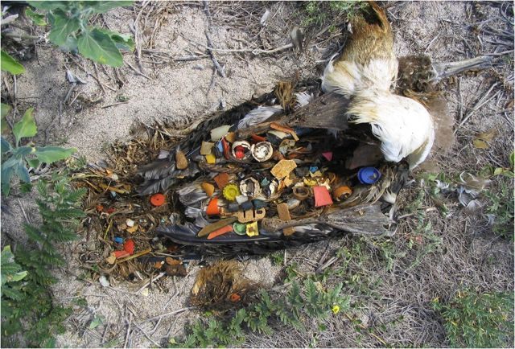

Slide 9
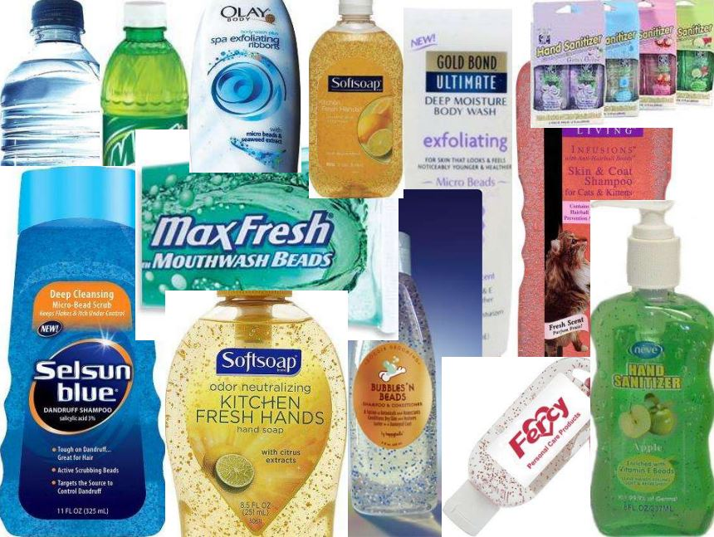
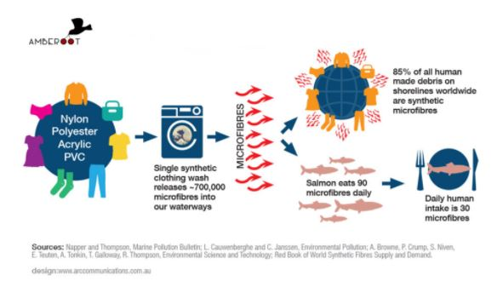
SOURCES OF MICROPLASTICS
Plastic products and personal care products with microbeads
Polyester, acrylic, PVC clothing

Slide 10
SOURCES OF MICROPLASTICS
Microbeads were banned from US products in 2016, but many products still contain polyethylene, polypropylene, polystyrene, PMMA, PET, PTFE, and nylon
Personal Care Products (PCPs)
Shampoos
Body washes
Toothpastes
Primary microplastics
Toothpastes and body wash go directly from the drain into the environment
Microplastics are too small to be filtered out of water at wastewater treatment plant
Secondary microplastics
Plastic bottles or containers
Released into the environment from improper waste disposal

Slide 11
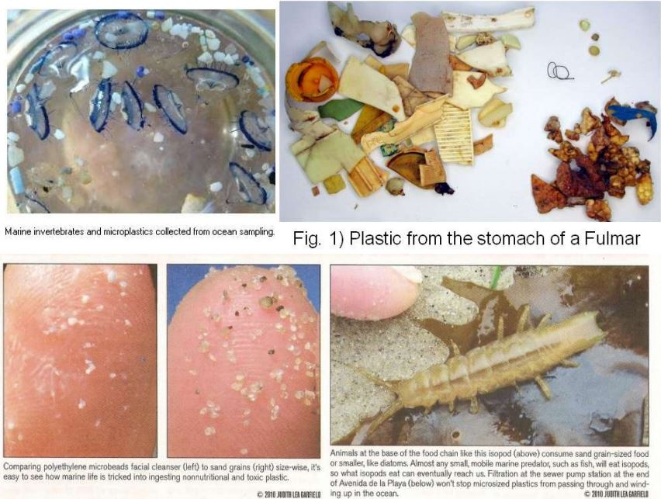

Slide 12
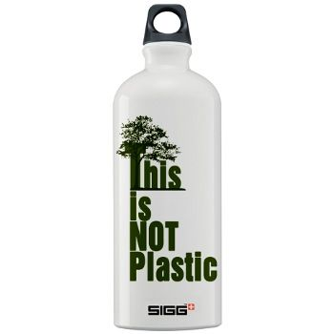
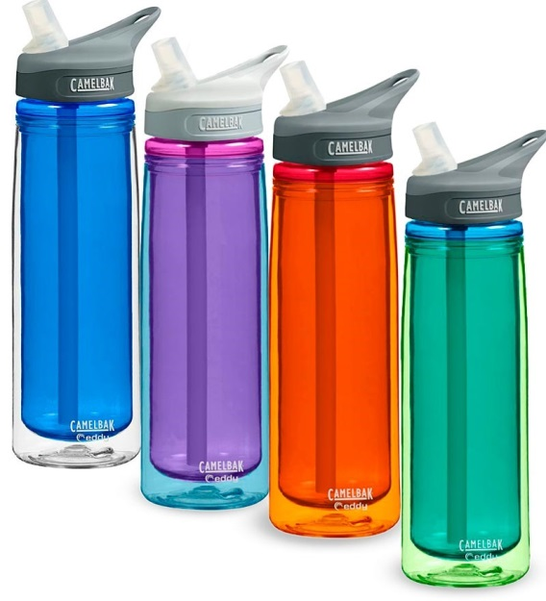
WHAT CAN BE DONE?
Don’t purchase items with the following chemicals in the ingredients:
Polyethylene, polypropylene, polystyrene, PMMA, PET, PTFE, and nylon
Use less plastics!
Find alternatives to plastic bags, bottles, and containers
Avoid heavily packaged food at the grocery store
Dispose of your plastics PROPERLY
Do not litter
Do not dump
Recycle
Reuse
Be sure they make it to a secure and sturdy garbage bag

Slide 13
BROUGHT TO YOU BY…
THE REGIONAL SCIENCE
CONSORTIUM

Slide 14
LEARN MORE AT…
www.RegSciConsort.com
www.RegSciTV.com

