Slide 1
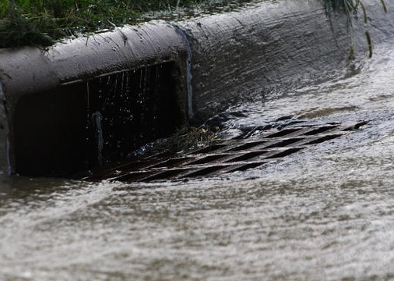
STORMWATER RUNOFF

Slide 2
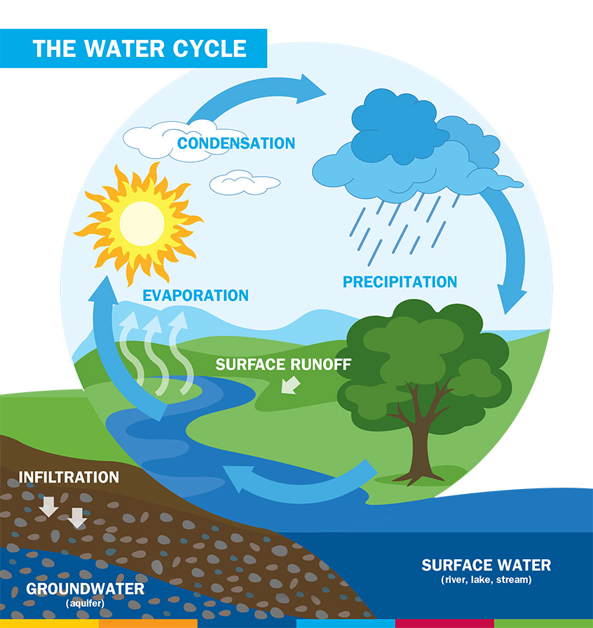
WHAT IS STORMWATER RUNOFF?
Stormwater
Water created by precipitation events, such as rainfall or snowmelt
Runoff
Water that does not infiltrate into the ground
Flows over land and impervious surfaces
Impervious surfaces: Surfaces that do not allow stormwater to percolate through the soils below them

Slide 3
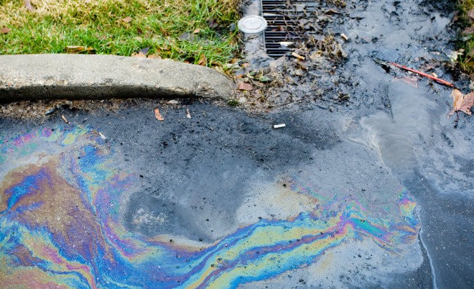
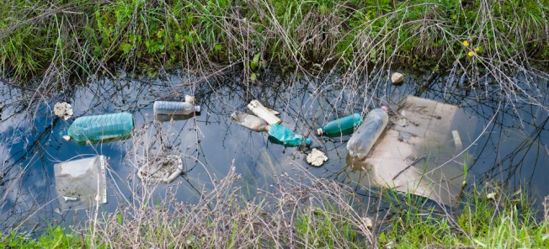
RUNOFF AND WATER QUALITY
Non-point pollution
Excess nutrients
Nitrogen & phosphorous
Litter
Plastic bottles, wrappers, etc.
Bacteria
From animal & human waste
Sediment
Pesticides
Metals
Petroleum products
Leaking vehicles
Source: https://www.usgs.gov/special-topic/water-science-school/science/runoff-surface-and-overland-water-runoff?qt-science_center_objects=0#qt-science_center_objects

Slide 4
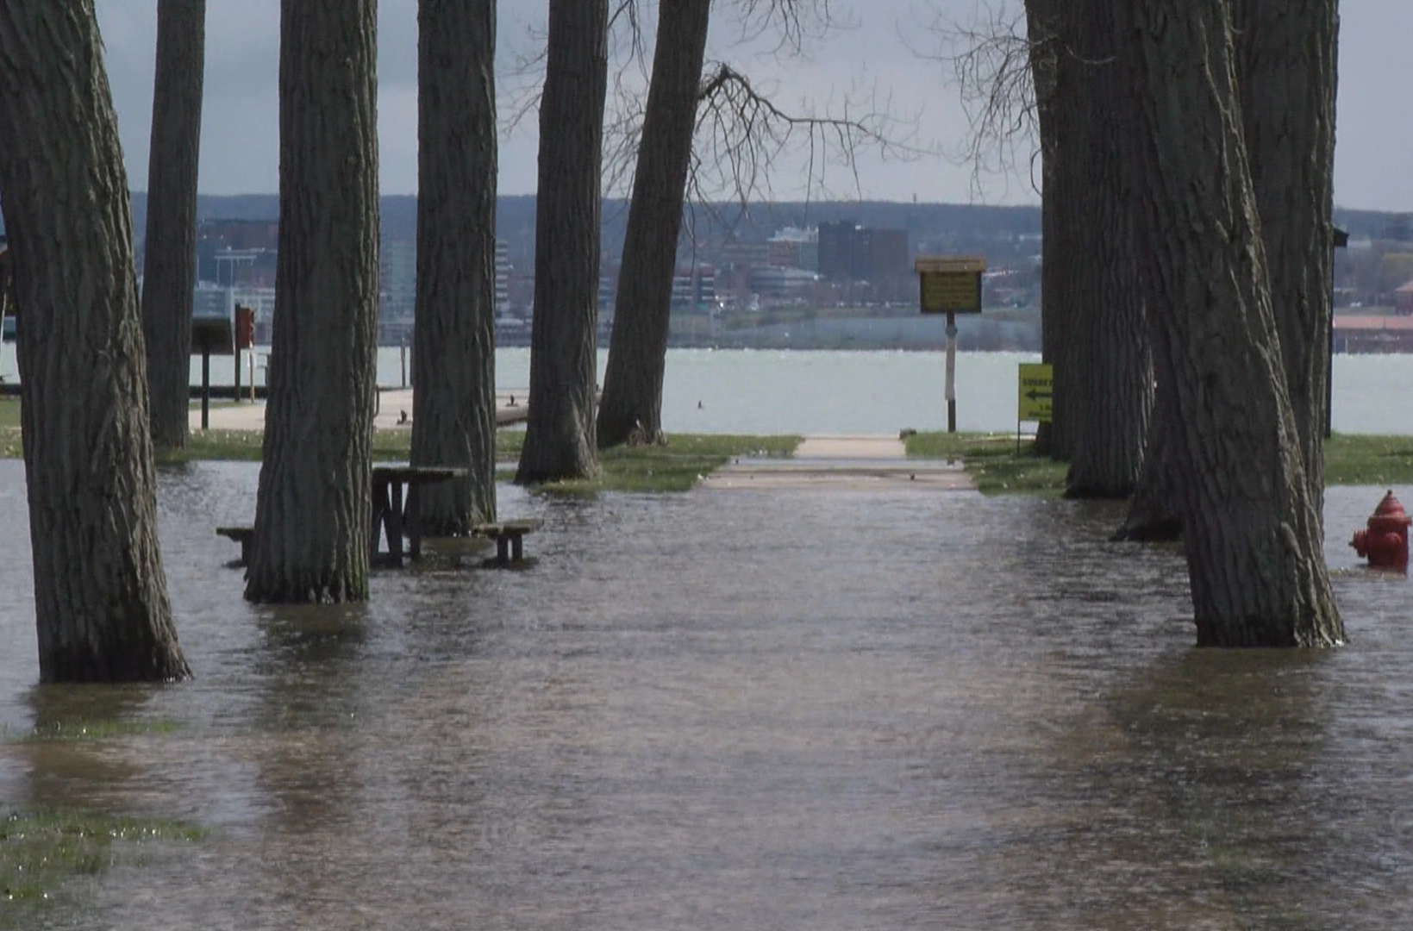
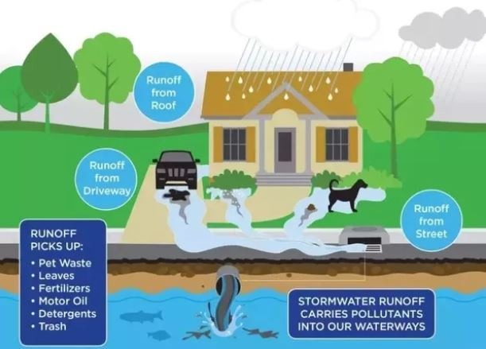
RUNOFF AND WATER QUALITY
Flooding
No where for water to go
Can be harmful to plants, animals, and people
Presque Isle State Park, Ferry Slip
Source: https://www.usgs.gov/special-topic/water-science-school/science/runoff-surface-and-overland-water-runoff?qt-science_center_objects=0#qt-science_center_objects

Slide 5
STORMWATER RUNOFF
Meteorological Factors
Physical Factors
Type of precipitation
Rain, snow, etc.
Rainfall intensity
Rainfall amount
Rainfall duration
Distribution of rainfall
One watershed or many
Storm movement
Soil moisture
Impervious & pervious surfaces
Land use
Vegetation
Soil type
Sand, clay, etc.
Drainage area
Slope
Topography
Surface water bodies
Lakes, streams, reservoirs, etc.
Source: https://www.usgs.gov/special-topic/water-science-school/science/runoff-surface-and-overland-water-runoff?qt-science_center_objects=0#qt-science_center_objects

Slide 6
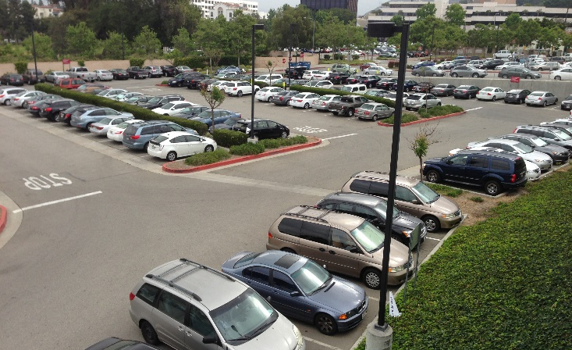
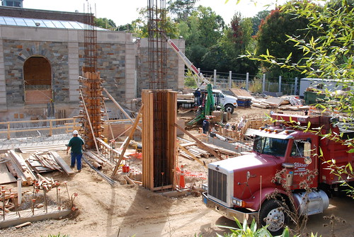
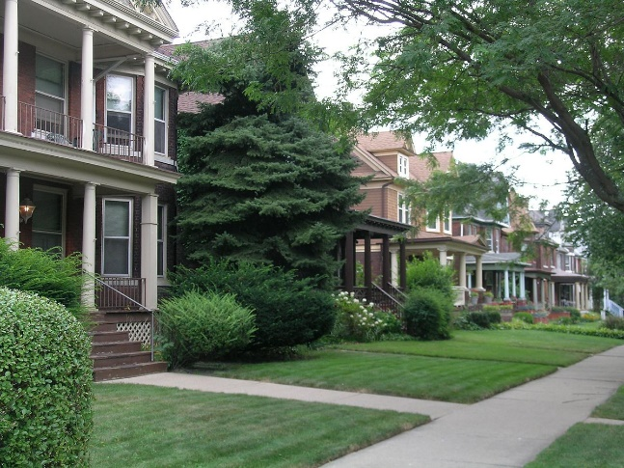
IMPERVIOUS SURFACES
Impervious
Roads
Parking lots
Driveways
Rooftops
Compacted soils
Lawns
Construction sites
Source: https://eriecountypa.gov/departments/planning-and-community-development/resources/stormwater-information/

Slide 7
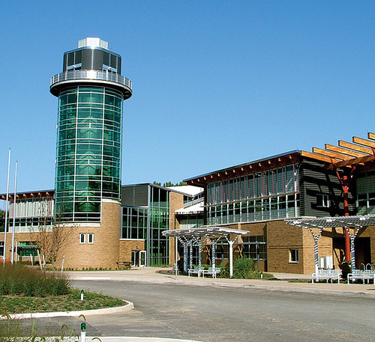
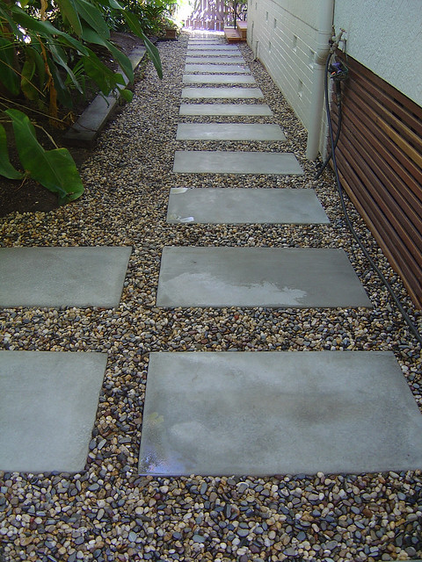
PERVIOUS SURFACES
Pervious
Paver stones
Pervious concrete
Porous asphalt
Mulch
Sand
Silt
Clay
Noncompacted soils
Lawns
Source: https://www.toaks.org/departments/public-works/sustainability/water/landscaping-and-lawns/pervious-surfaces

Slide 8
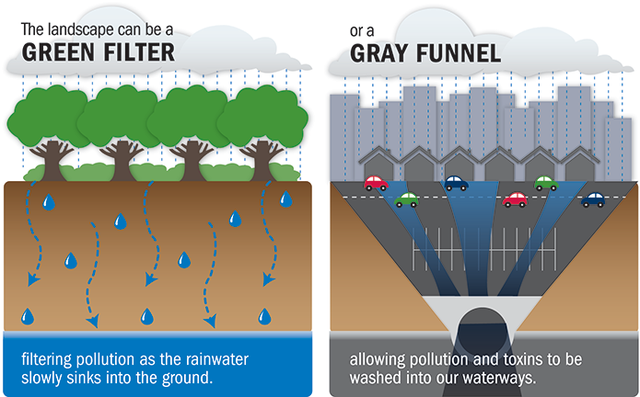
BENEFITS OF PERVIOUS SURFACES
Recharge groundwater
Allow water to reach and contribute to the water table
Filter out pollutants in the water
Reduce contamination of surface waters
Rivers, lakes, streams, oceans
Less runoff = less pollutants
Source: https://www.toaks.org/departments/public-works/sustainability/water/landscaping-and-lawns/pervious-surfaces

Slide 9
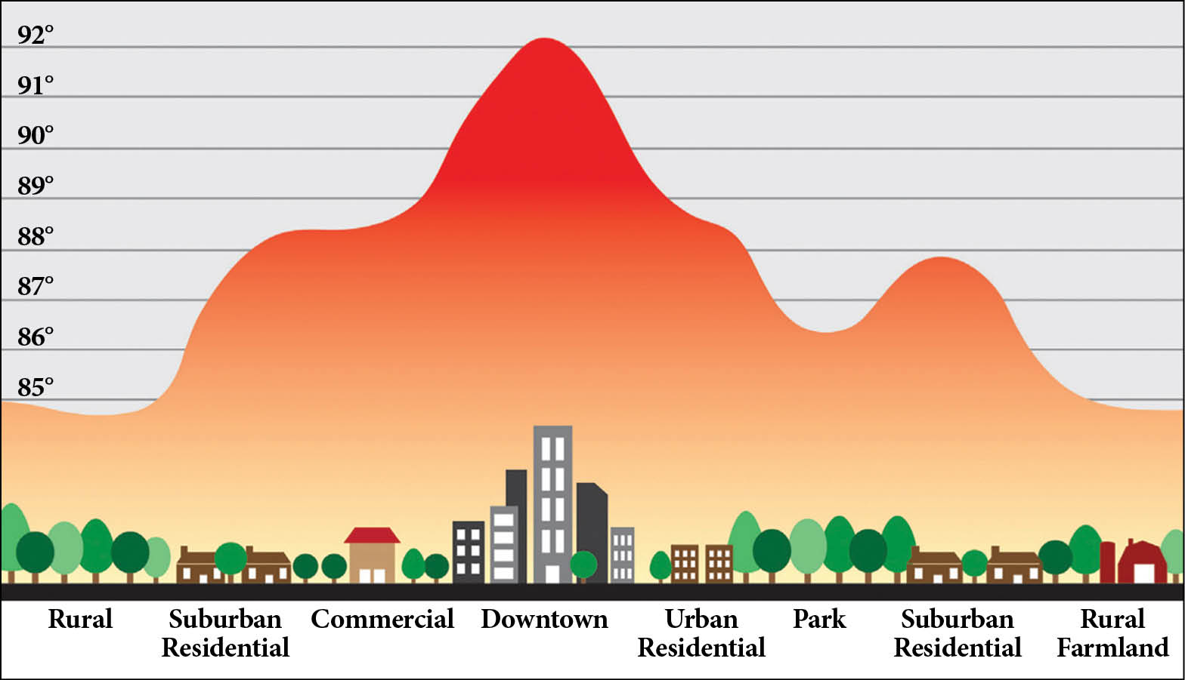
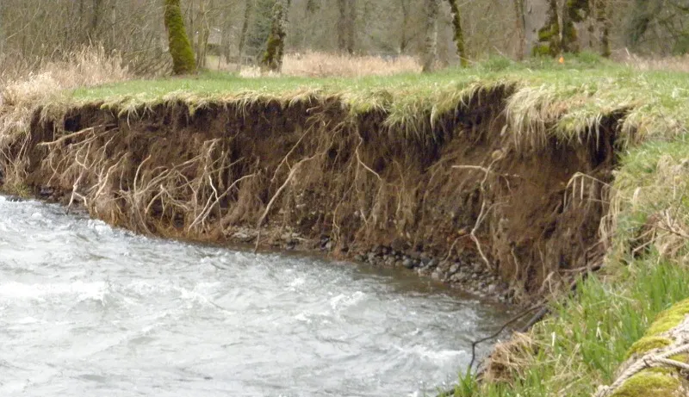
BENEFITS OF PERVIOUS SURFACES
Reduce the heat island effect
Impervious surfaces absorb more heat
Considerably hotter
Take more energy to cool
Air conditioning
Most pervious surfaces do not contribute to this problem
Reduce flooding
Water is absorbed and cannot build up
Reduced erosion
Less runoff
Source: https://www.toaks.org/departments/public-works/sustainability/water/landscaping-and-lawns/pervious-surfaces

Slide 10
STORMWATER MANAGEMENT
Reduces or eliminates the negative impacts of runoff
Includes
Controlling flooding
Reducing erosion
Improving water quality
Accomplished by implementing Best Management Practices (BMPs)
Structural, vegetative, or managerial practices
Used to treat, prevent, or reduce water pollution
Source: https://www.michigan.gov/documents/deq/ess-nps-savvy-bmp_209386_7.pdf

Slide 11
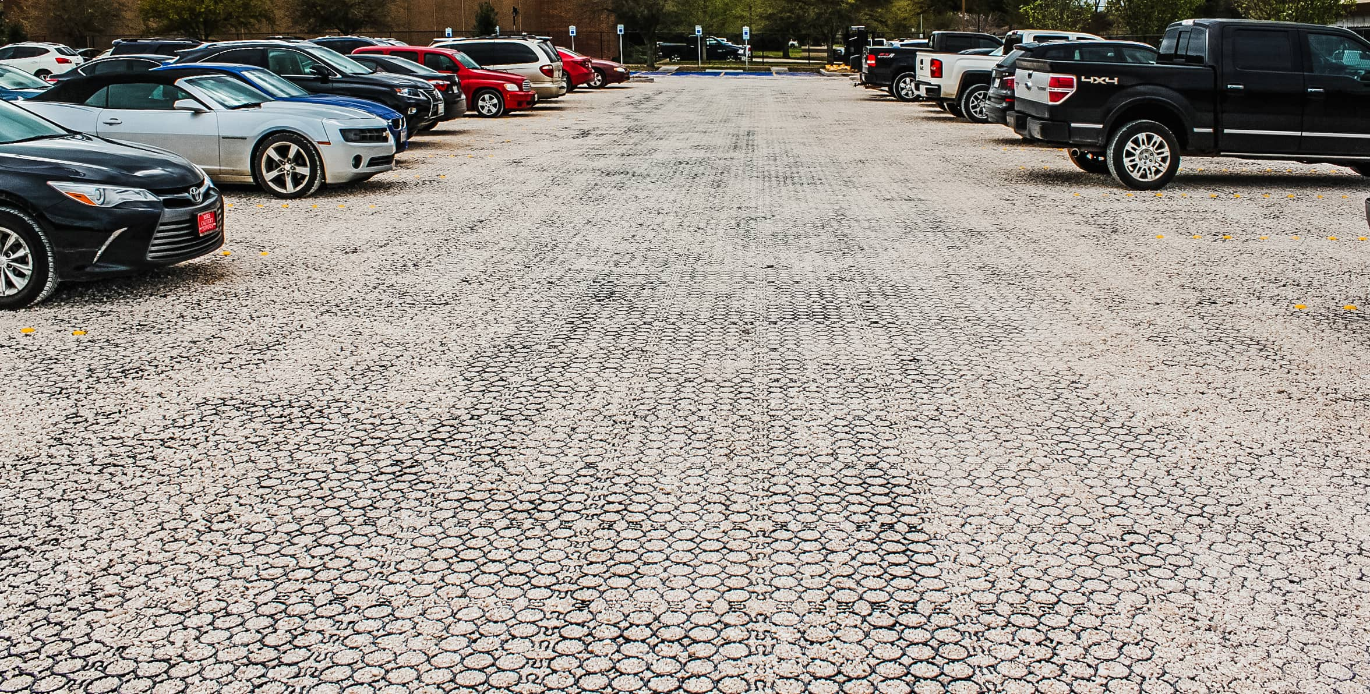
BEST MANAGEMENT PRACTICES (BMPs)
Permeable surfaces
Allows water to infiltrate pavement and enter soil
Removes fine grain pollutants and provides erosion control
Pervious pavement, pavers, etc.
Source: https://www.michigan.gov/documents/deq/ess-nps-savvy-bmp_209386_7.pdf

Slide 12
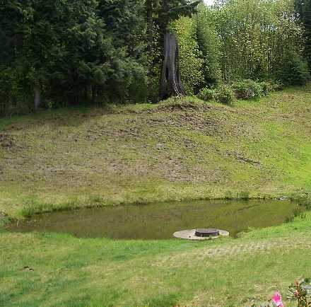
BEST MANAGEMENT PRACTICES (BMPs)
Extended Detention Ponds
Hold stormwater until pollutants settle to the bottom
Water is released slowly into nearby water body
Reduces flooding and pollution in system
Water pond/detention ponds
Allow incoming runoff to replace existing pond water
Pollutants settle to the bottom preventing from entering system
Provides minimal flood protection
Infiltration basins
Capture stormwater and allow it to filter back into the ground
Can be clogged by coarse grained pollutants
Source: https://www.michigan.gov/documents/deq/ess-nps-savvy-bmp_209386_7.pdf

Slide 13
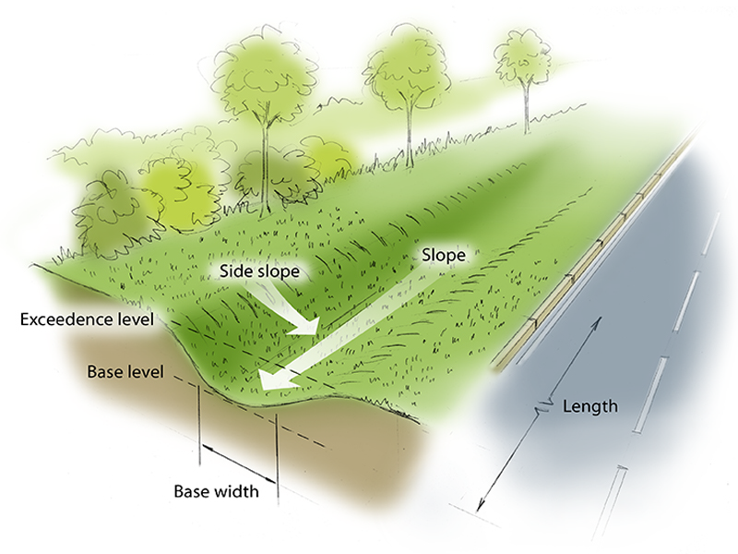
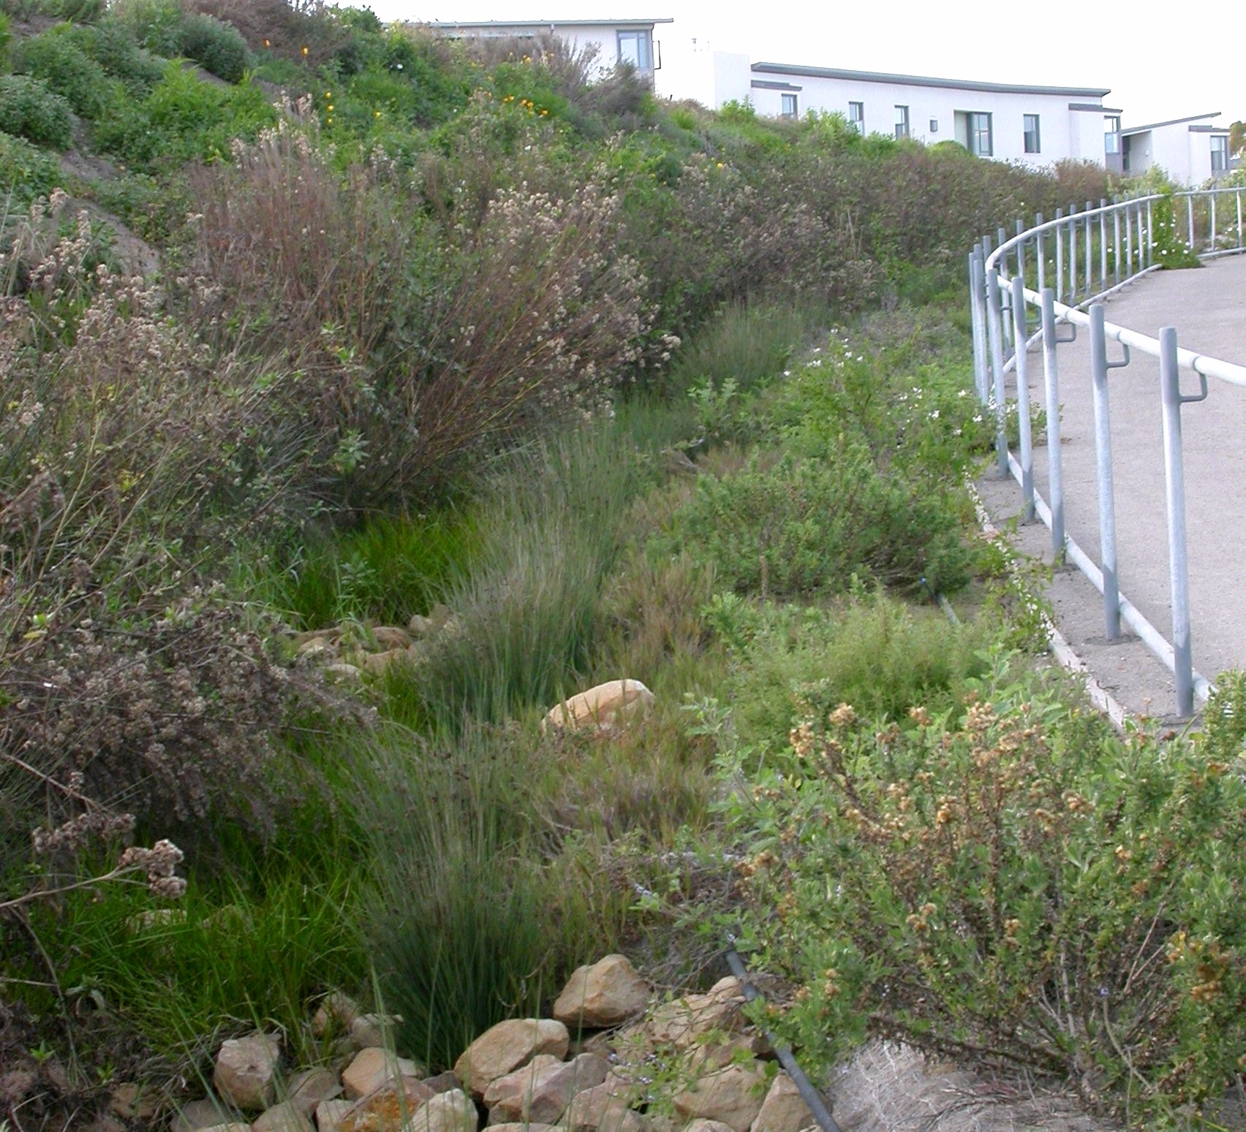
BEST MANAGEMENT PRACTICES (BMPs)
Basins/swales/strips
Improve water quality by filtering heavy metals, nutrients, suspended solids, oils and grease
Reduce storm water volume by storing runoff
Typically vegetated along the channel bottom and sides
Source: https://deq.utah.gov/water-quality/low-impact-development

Slide 14
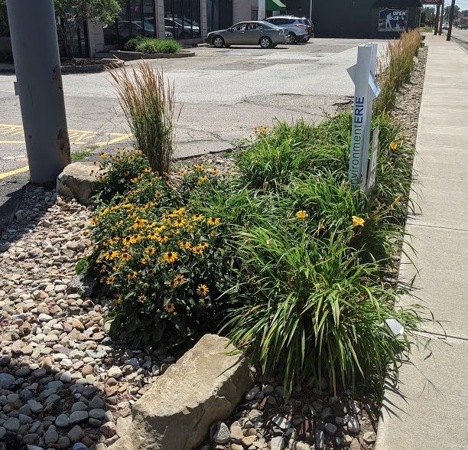
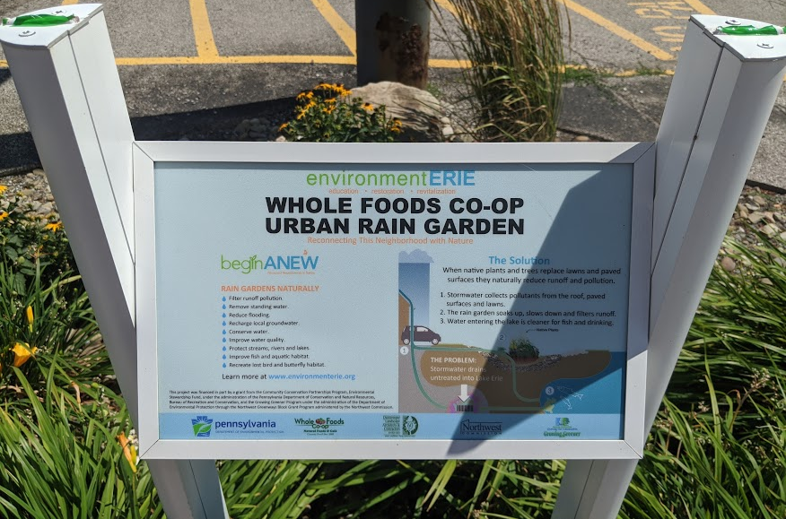
BEST MANAGEMENT PRACTICES (BMPs)
Rain Gardens
Small-scale, shallow vegetated depressions that store and filter storm water or runoff from impervious surfaces
Include compost-amended native soils planted with native trees, shrubs, plants and groundcovers
Great for any location
Source: https://deq.utah.gov/water-quality/low-impact-development

Slide 15
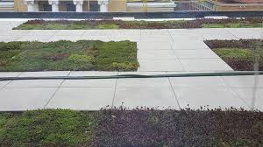
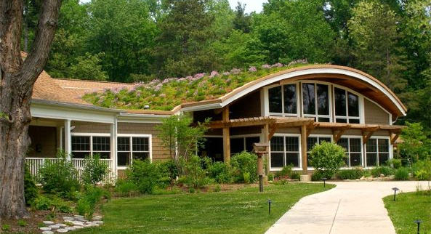
BEST MANAGEMENT PRACTICES (BMPs)
Green roofs
Mitigate the effects of urbanization on water quality by filtering, absorbing or detaining rainfall
Constructed of lightweight soil media including a drainage layer and impermeable membrane to protect the building structure
Special plants that thrive in the harsh, dry, high temperatures of the roof and tolerate short, intense periods of rainfall
Source: https://deq.utah.gov/water-quality/low-impact-development

Slide 16
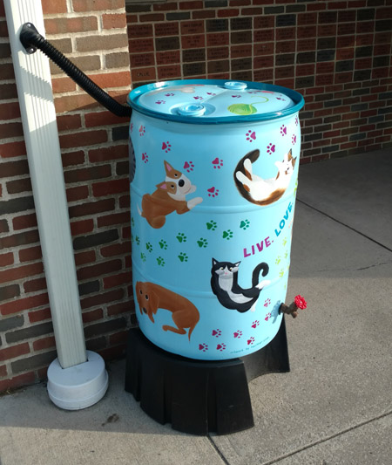
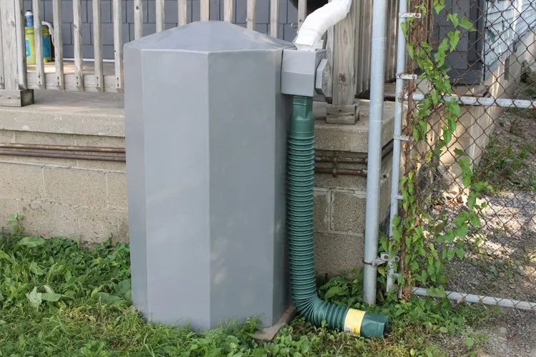
BEST MANAGEMENT PRACTICES (BMPs)
Rain barrel
Captures water runoff from impervious surfaces such as roof and stores it for later use
Reduces the amount of runoff
Conserves water and a source of free water
Source: https://www.epa.gov/soakuptherain/soak-rain-rain-barrels#:~:text=Rain%20barrels%20capture%20water%20from,for%20use%20in%20your%20landscape.

Slide 17
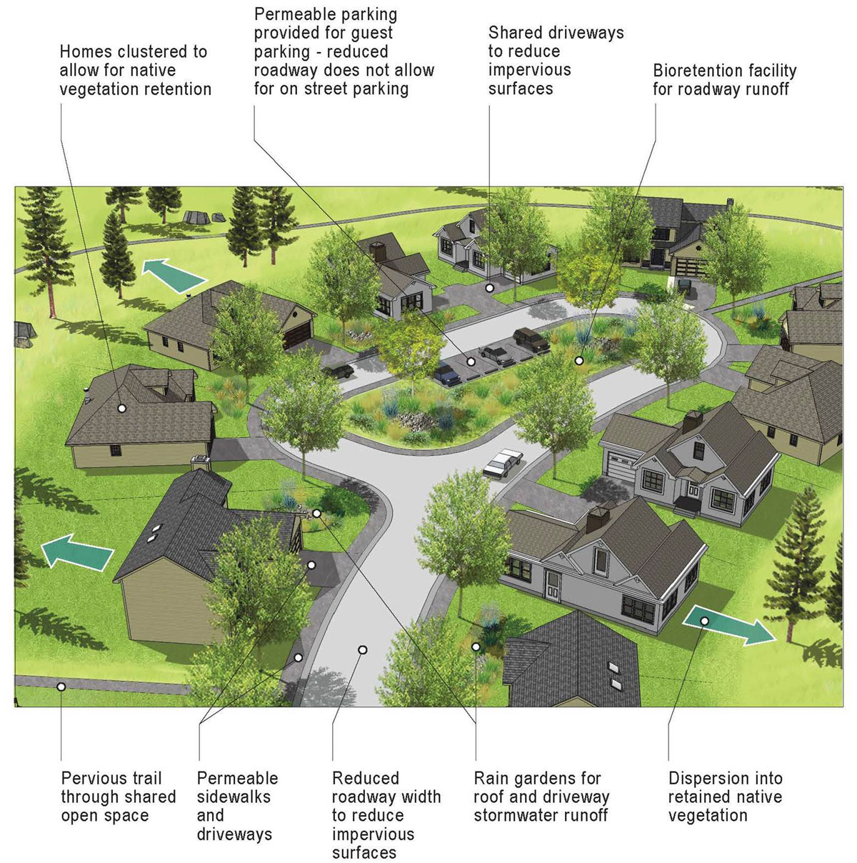
Example of a stormwater friendly neighborhood
Source: https://deq.utah.gov/water-quality/low-impact-development

Slide 18
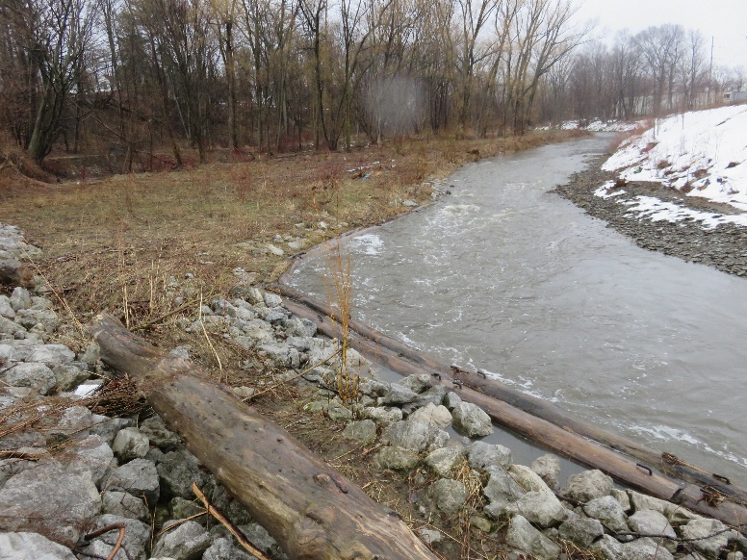
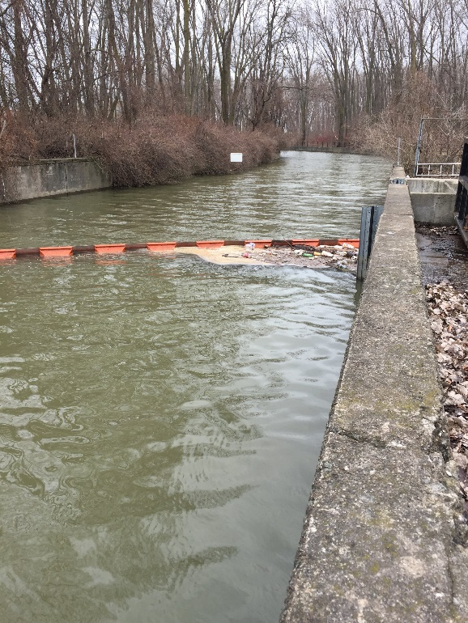
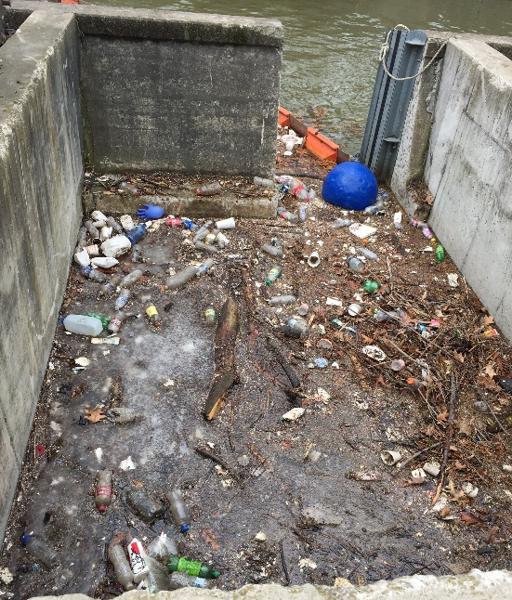
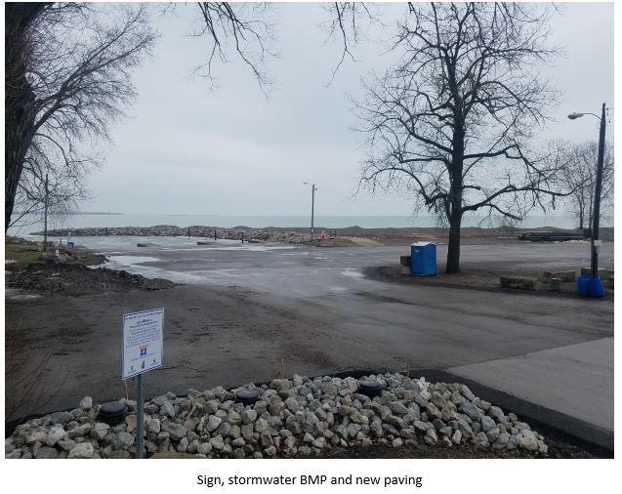
STORMWATER BMPs IN ERIE, PA

Slide 19
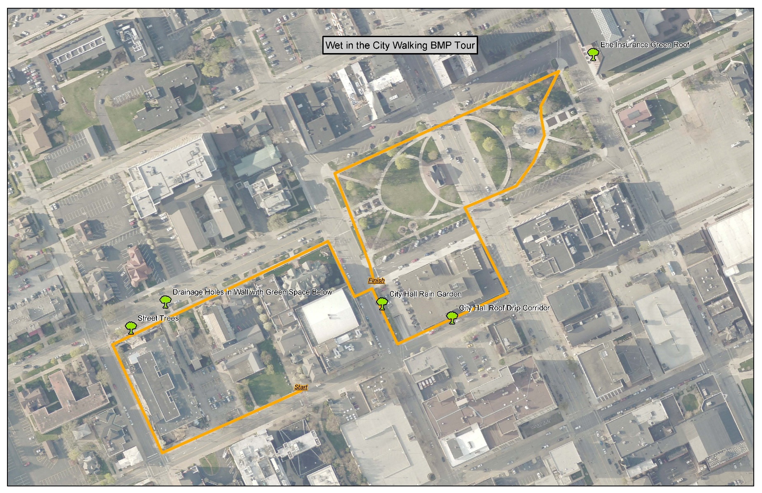
STORMWATER BMPs IN ERIE, PA

Slide 20
IDENTIFYING IMPERVIOUS & PERVIOUS SURFACES
Answer each of the questions below for the following images
Mostly pervious or impervious surfaces?
How well does this area manage stormwater runoff?

Slide 21
IDENTIFY PERVIOUS & IMPERVIOUS SURFACES IN THE IMAGE BELOW

Slide 22
IDENTIFY PERVIOUS & IMPERVIOUS SURFACES IN THE IMAGE BELOW

Slide 23
BROUGHT TO YOU BY…
THE REGIONAL SCIENCE
CONSORTIUM

Slide 24
LEARN MORE AT…
www.RegSciConsort.com
www.RegSciTV.com

