Slide 1
EROSION
Effects and mitigation on Presque Isle, Erie, PA

Slide 2
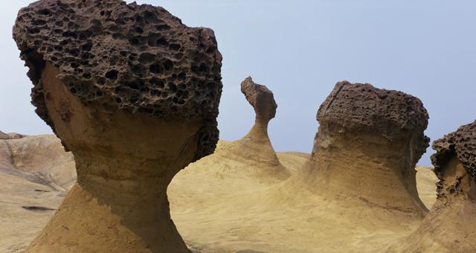
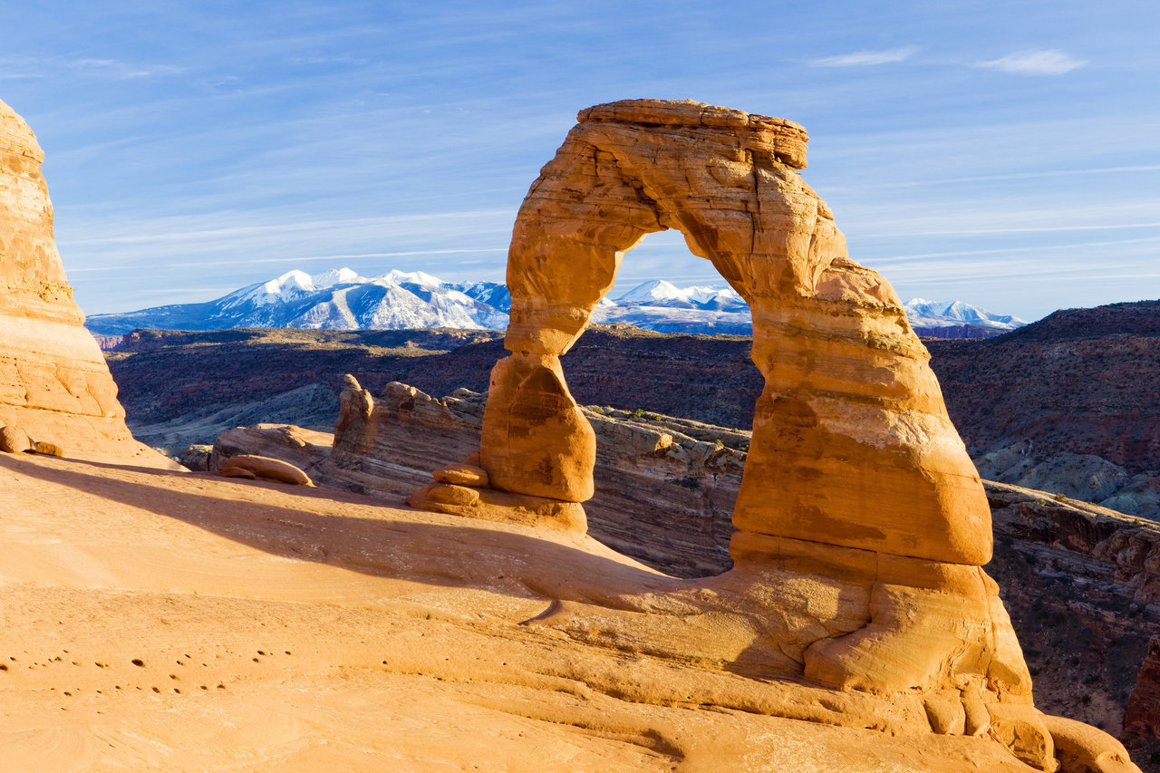
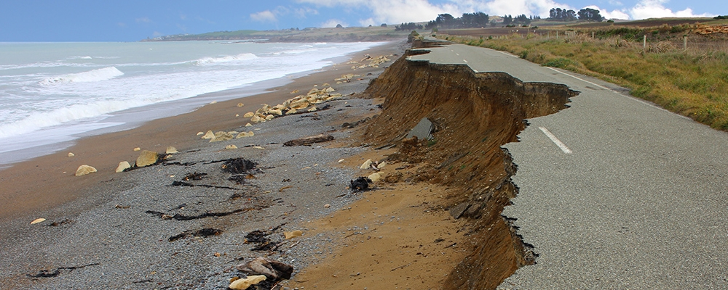
WHAT IS EROSION?
The geologic process wherein earthen materials (soil, rock, etc) are worn away and transported by natural forces such as wind or water
Sources: https://blog.dhigroup.com/2018/01/22/technology-helping-professionals-manage-coastal-erosion-successfully/
https://www.macmillandictionary.com/dictionary/british/erosion
https://phys.org/news/2017-12-scientists-erosion-unusual.html

Slide 3
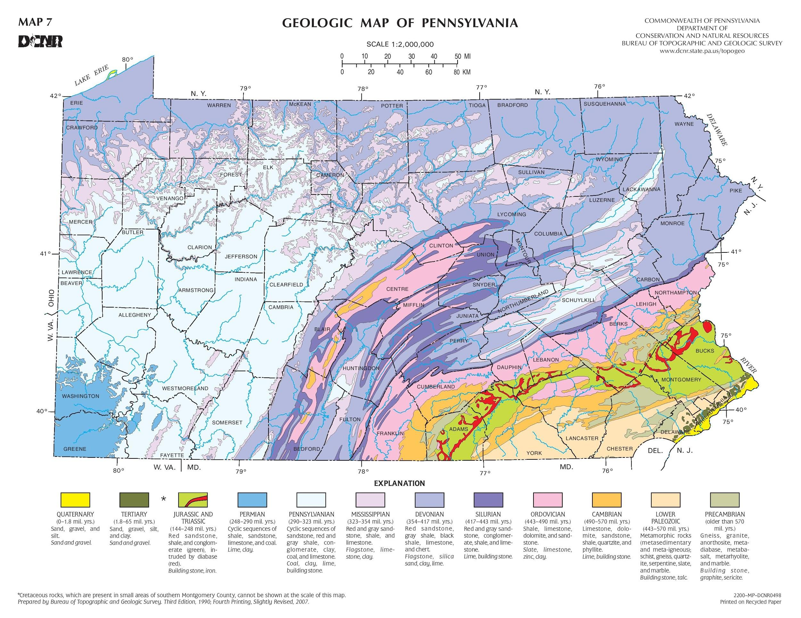

Slide 4
BRIEF NATURAL HISTORY OF PRESQUE ISLE
Shaped by Wisconsin Glacial Episode in late Wisconsin age ~23,000 ya
Southern lobe of glacier carved out Great Lakes, left many other features
Laurentide Ice Sheet; Lake Erie Lobe
When glaciers retreat, they drop everything right where it was held in the ice

Slide 5
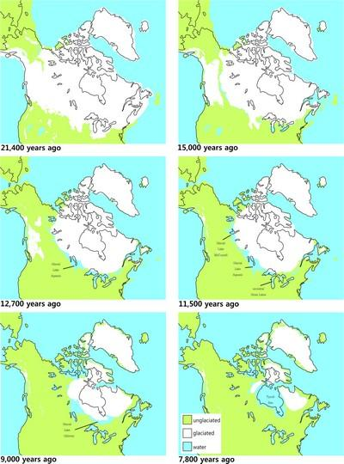
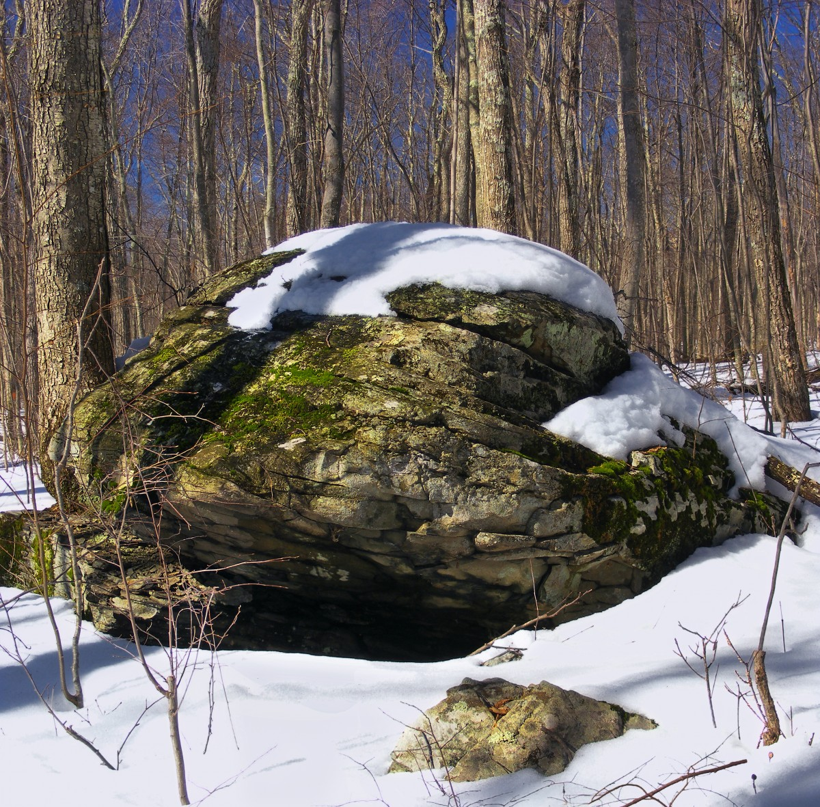
LAURENTIDE ICE SHEET
Source: http://science.gc.ca/eic/site/063.nsf/eng/97235.html

Slide 6
PRESQUE ISLE GEOLOGY
Composed entirely of unconsolidated glacial sediment
Sediment was left in a ridge along southern edge of escarpment that would fill to become Lake Erie as glacier melted
Through erosive forces this sediment ridge gradually formed into Presque Isle
Original deposition area of the ridge currently sits 30-50 ft below lake level

Slide 7
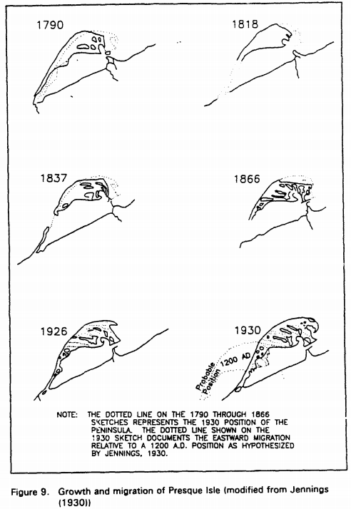
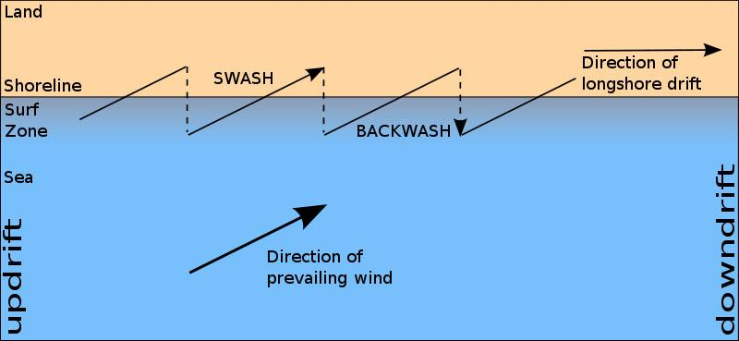
PRESQUE ISLE GEOLOGY
Source: https://apps.dtic.mil/dtic/tr/fulltext/u2/a270183.pdf

Slide 8
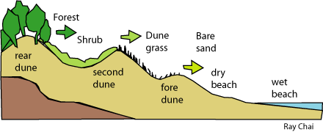
SAND DUNES
As offshore winds come onshore, sand is blown towards land
Sand can become stuck in vegetation, leading to the gradual growth a dune
Dune provides a physical barrier to wave action as well as providing plant habitat, further strengthening dune
As dune continues to migrate, a new dune begins to form
A dune succession is created
Source: http://www.landforms.eu/Lothian/dune%20succession.htm

Slide 9
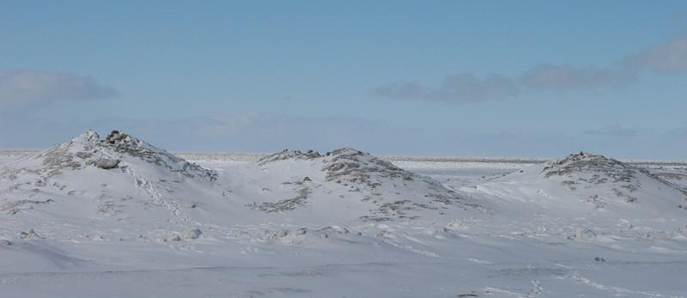
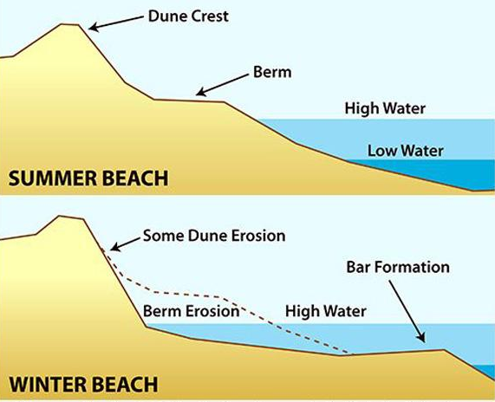
WINTER BEACH AND ICE DUNES
A beach has 2 profiles
Summer and winter
During summer beaches accumulate sand
Due to increased wind and storms in winter, beaches experience higher water & waves
Result in more erosion in winter
Ice Dunes form over beach sand as natural “armor”
Source: https://www.friendsofibsp.org/breaking-news/science-of-the-shore-a-tale-of-two-beaches-winter-summer-beach-profiles/

Slide 10
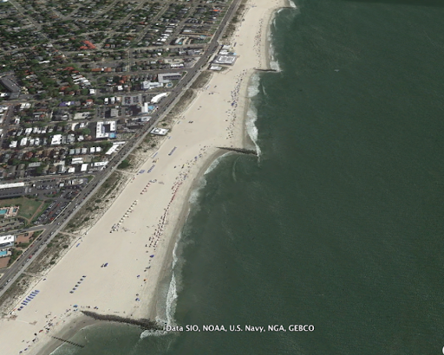
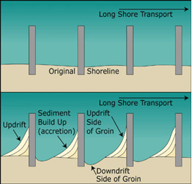
GROINS
Source: https://www.nccoast.org/protect-the-coast/advocate/terminal-groins/

Slide 11
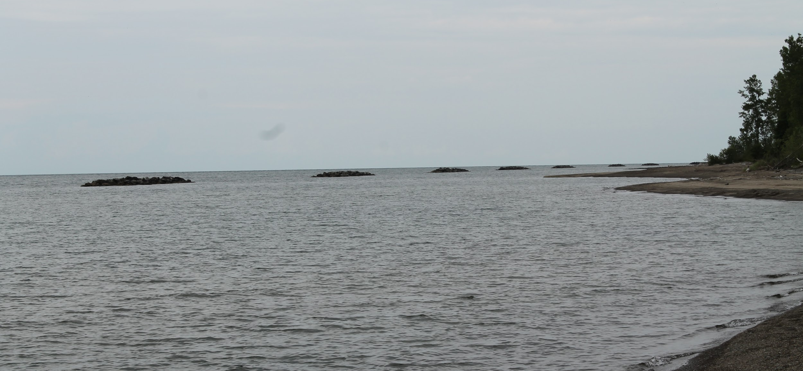
ADDITION OF BREAKWATERS
~$35 million dollar project approved July 27, 1988
Experimental prototypes done in early 80’s
58 breakwaters were constructed along Presque Isle’s lake shore
Starting in 1989
Intended to work as wave attenuators and reduce the erosional force of Lake Erie against the Presque Isle Shoreline

Slide 12
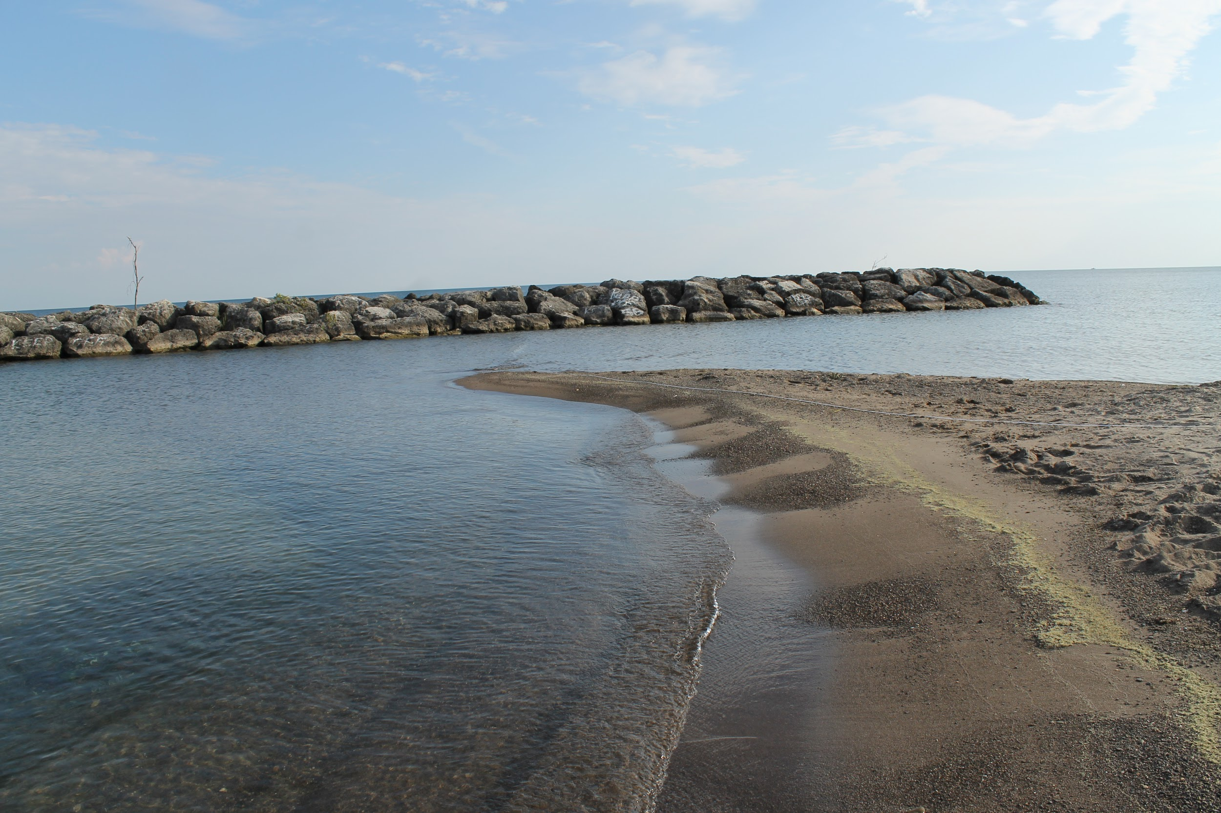
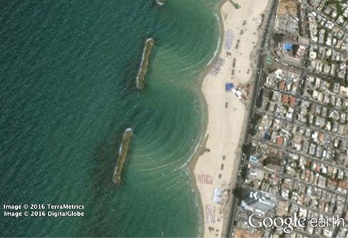
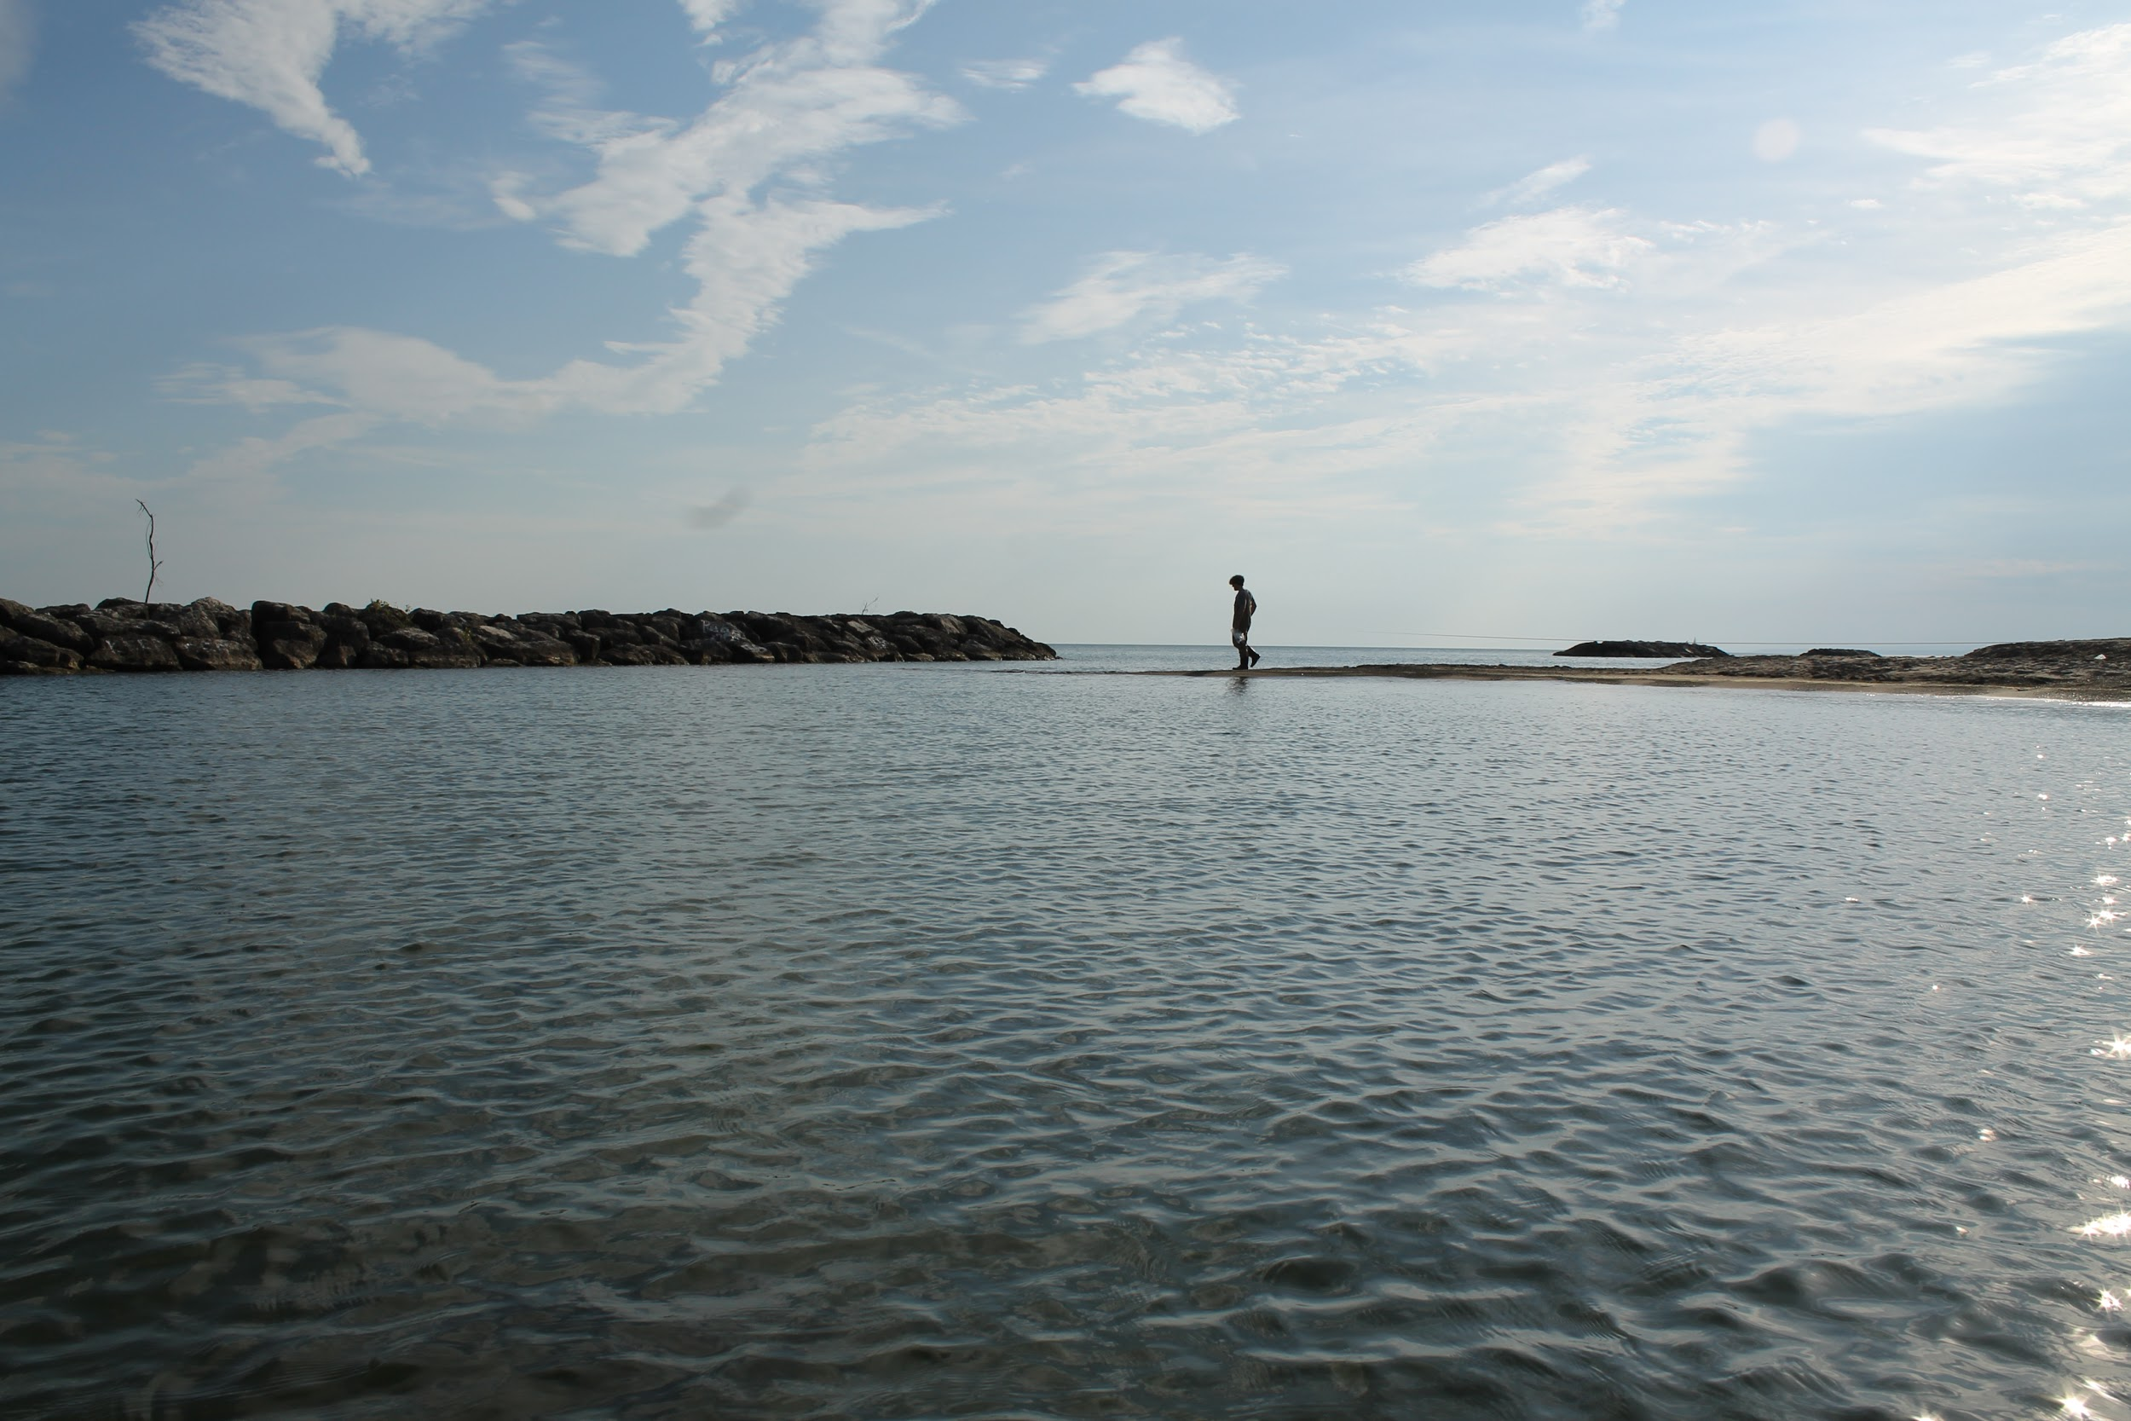
CURRENT ISSUES: TOMBOLOS
Source: https://openstax.org/books/university-physics-volume-3/pages/4-1-single-slit-diffraction

Slide 13
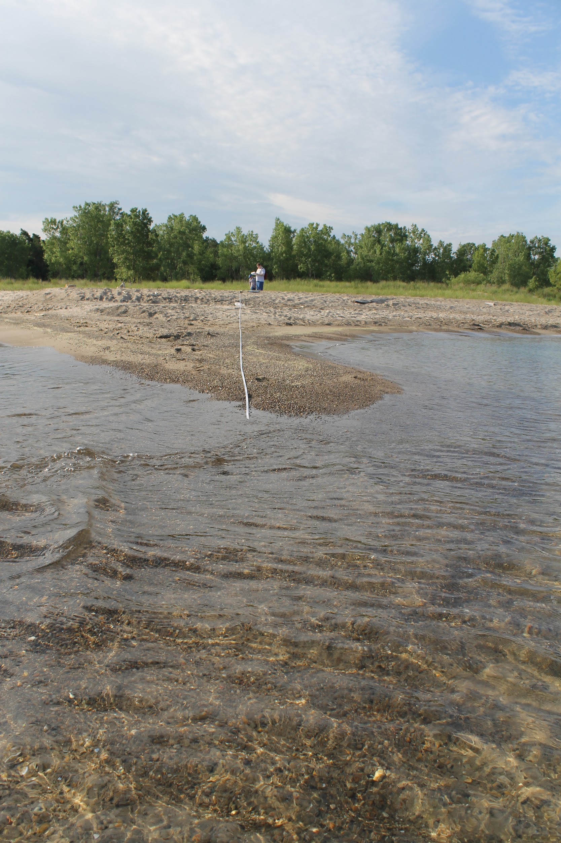
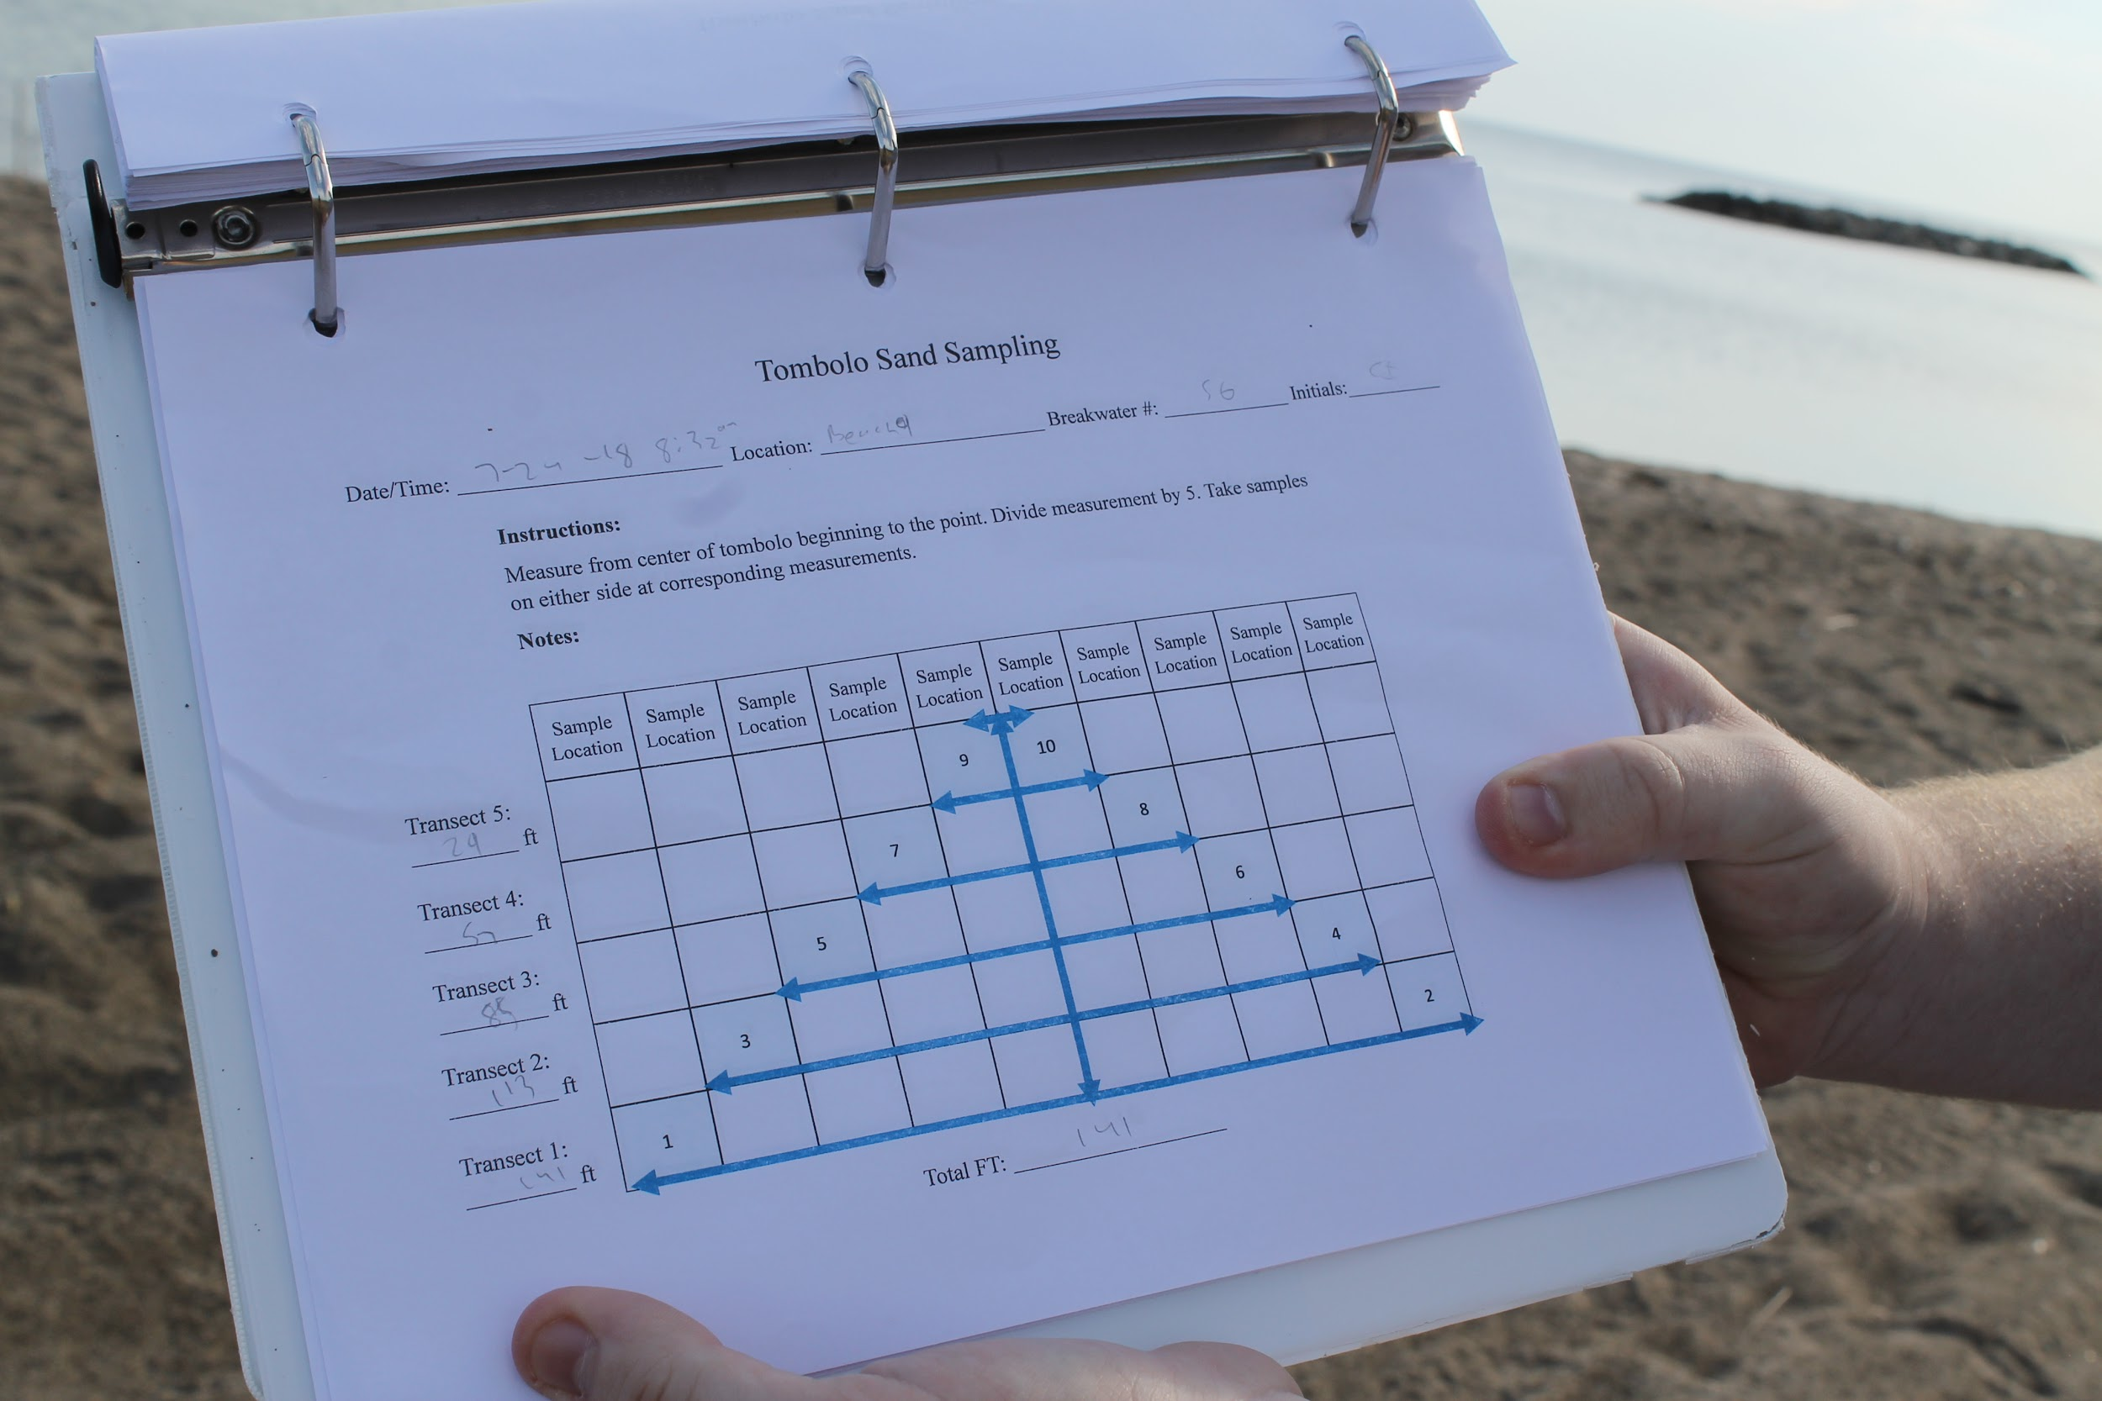
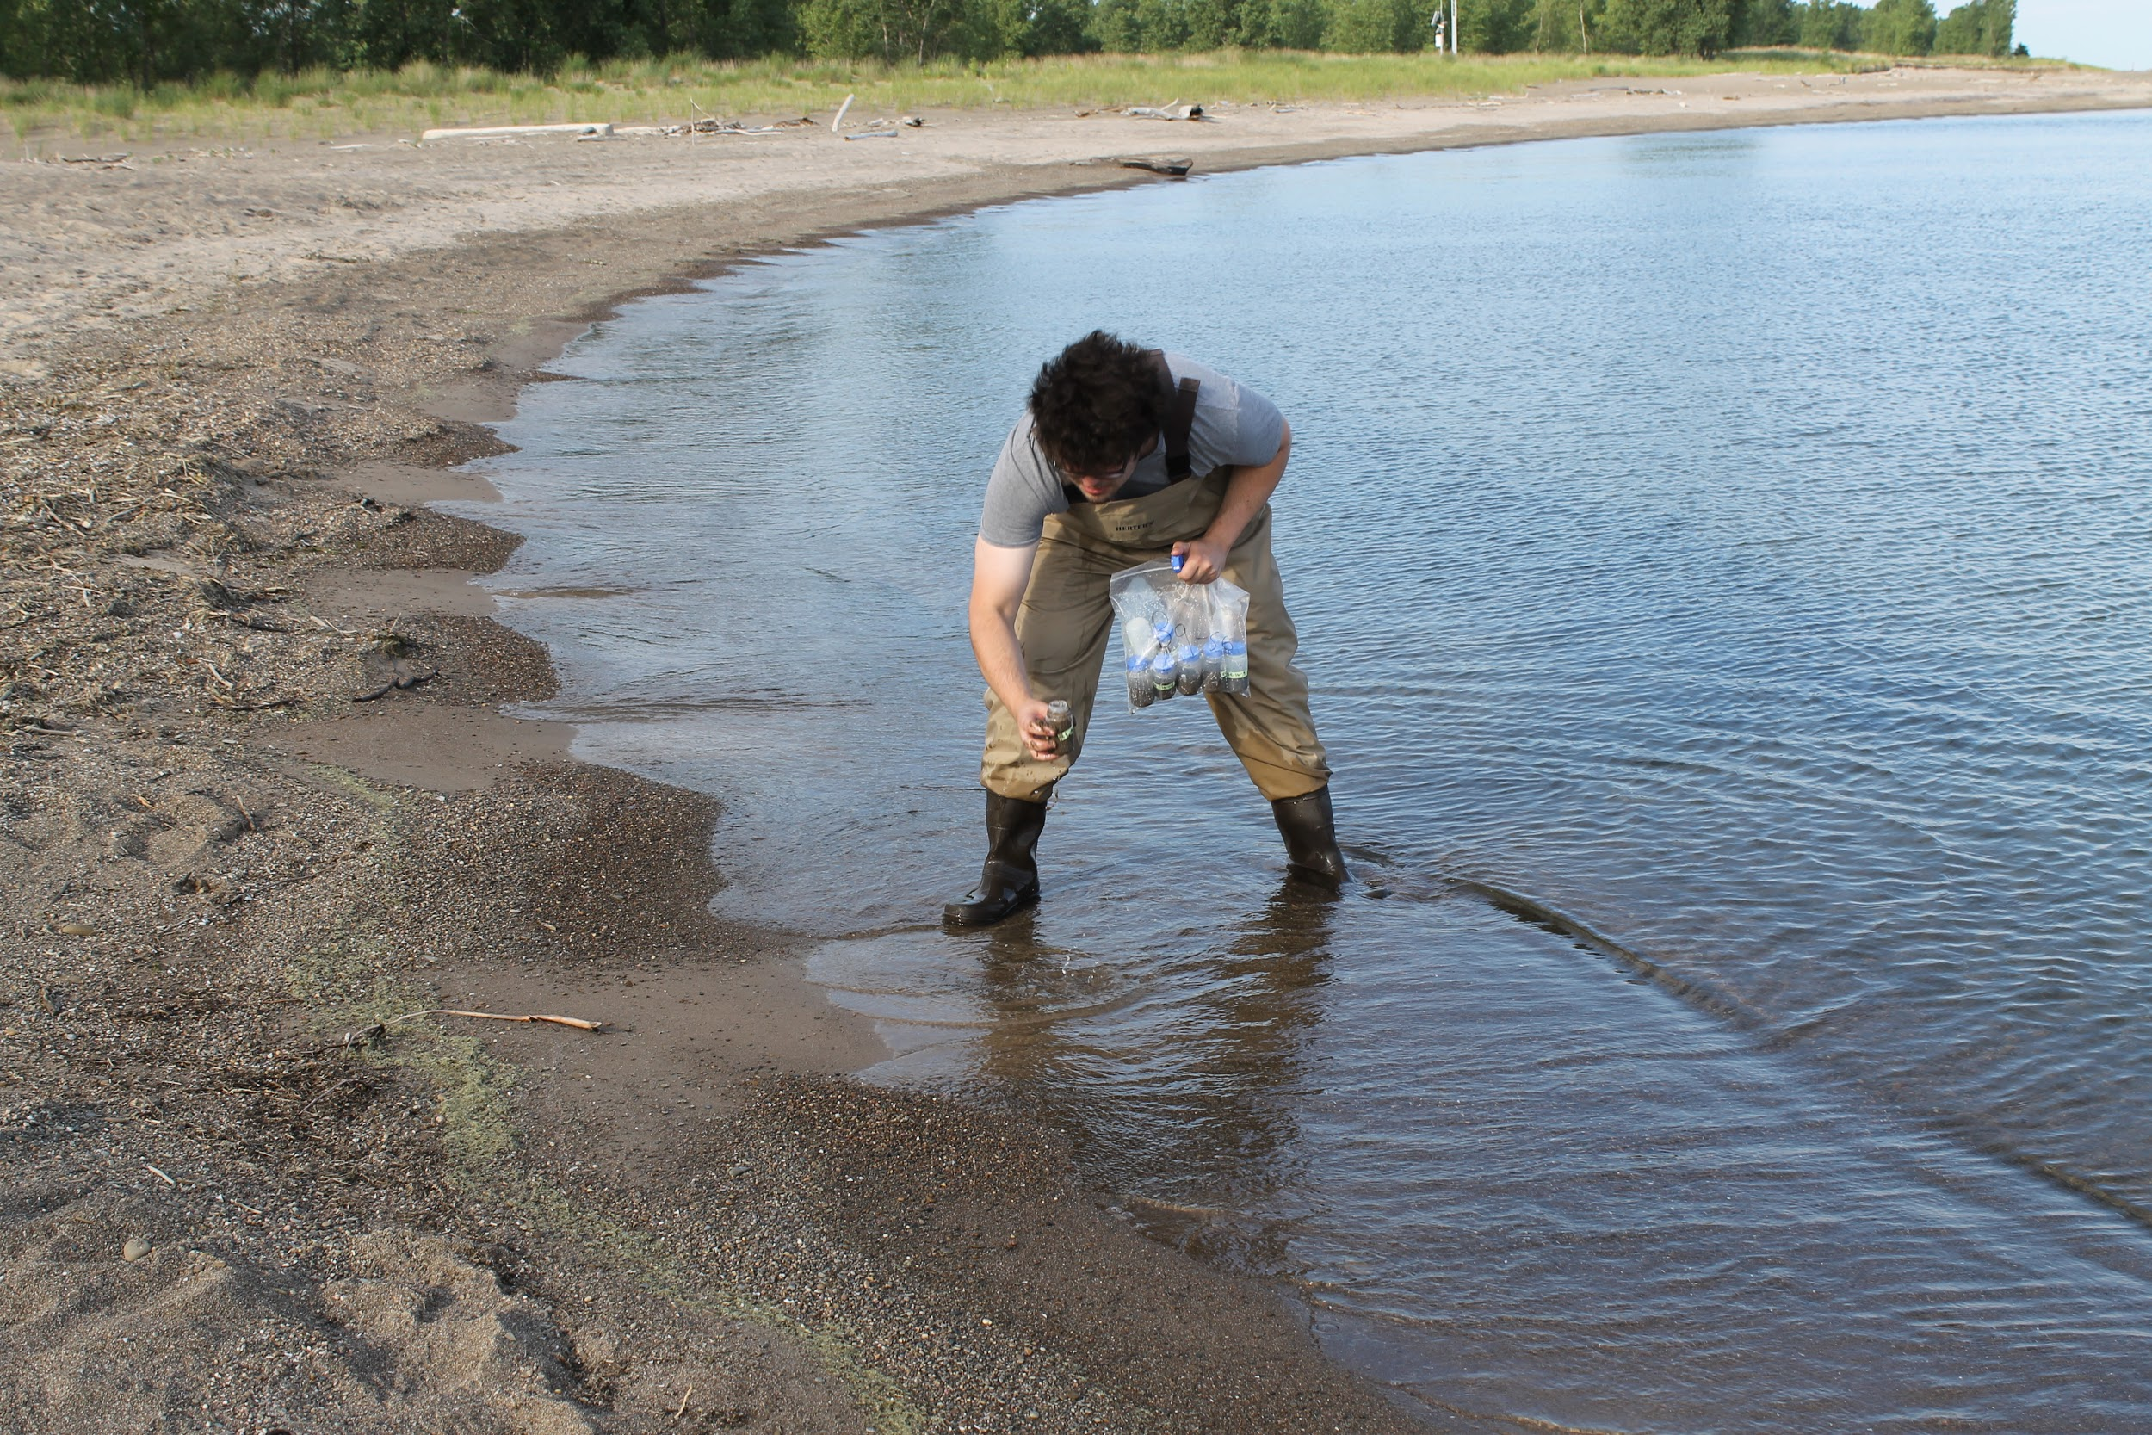
TOMBOLO SAMPLING AND ANALYSIS

Slide 14
TOMBOLO ANALYSIS CONTINUED
Samples are prepared and placed in a drying oven for 24 hours
After drying samples are weighed
Samples are then sieved to determine grain size composition
Knowing grain sizes of tombolo formations allows for more efficient replenishment efforts

Slide 15
PARK EROSION MITIGATION EFFORTS
Sand is replenished to beaches throughout the summer
Sand is trucked from North Pier to target beaches with dump trucks
Cost of sand replenishment ranges from $1-3 million per year depending on amount needed
Tombolos are dug out with excavators and sand is added to replenishment stock

Slide 16
BROUGHT TO YOU BY…
THE REGIONAL SCIENCE
CONSORTIUM

Slide 17
LEARN MORE AT…
www.RegSciConsort.com
www.RegSciTV.com

