Slide 1
ROCKS AND MINERALS
Types and Composition

Slide 2
WHAT IS A ROCK?
Categorized depending on origin of creation
Sedimentary: formed by the lithification of accumulated sediments
Shale, Sandstone
Igneous: solidified molten material
Granite, Basalt, Rhyolite
Metamorphic: rocks that have been transformed by extreme heat and pressure
Limestone > Marble
Shale > Slate
Granite > Gneiss
Rock: consolidated material consisting of one or more minerals

Slide 3
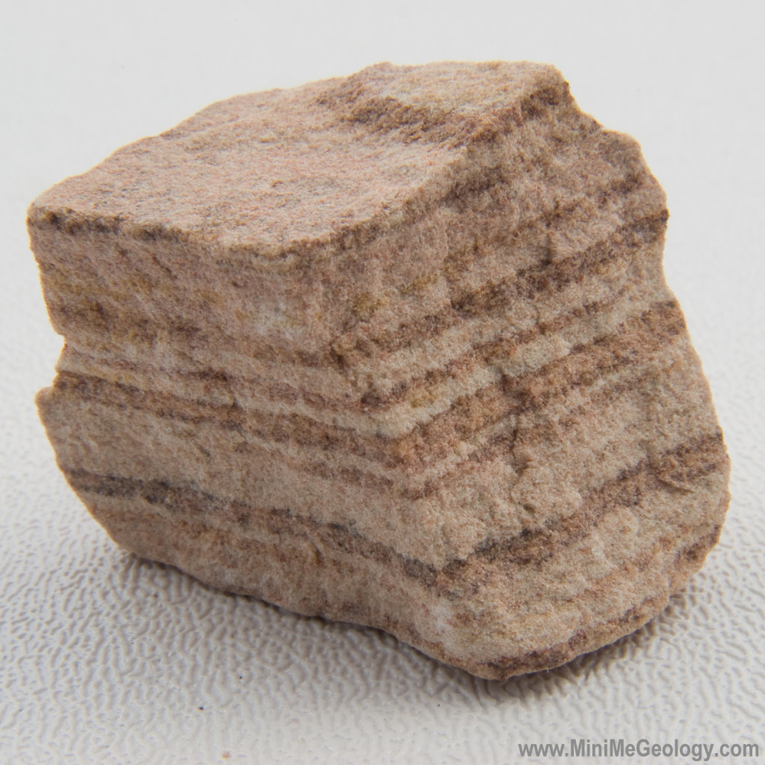
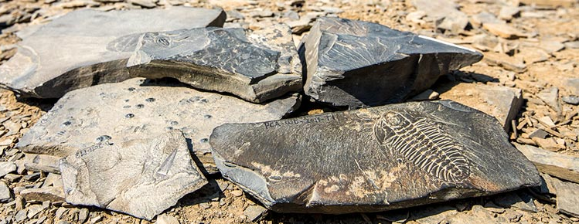
SEDIMENTARY ROCKS
Rocks that are formed by the lithification of accumulated sediments
Sediment: any material that is moved and deposited in a new location
Includes rocks, plants, and organic matter
Range in size from a grain of sand to a large boulder
Includes shales, slates, and sandstones
Sources: https://www.pc.gc.ca/en/pn-np/bc/yoho/activ/burgess
https://www.minimegeology.com/sandstone-sedimentary-rock-banded

Slide 4
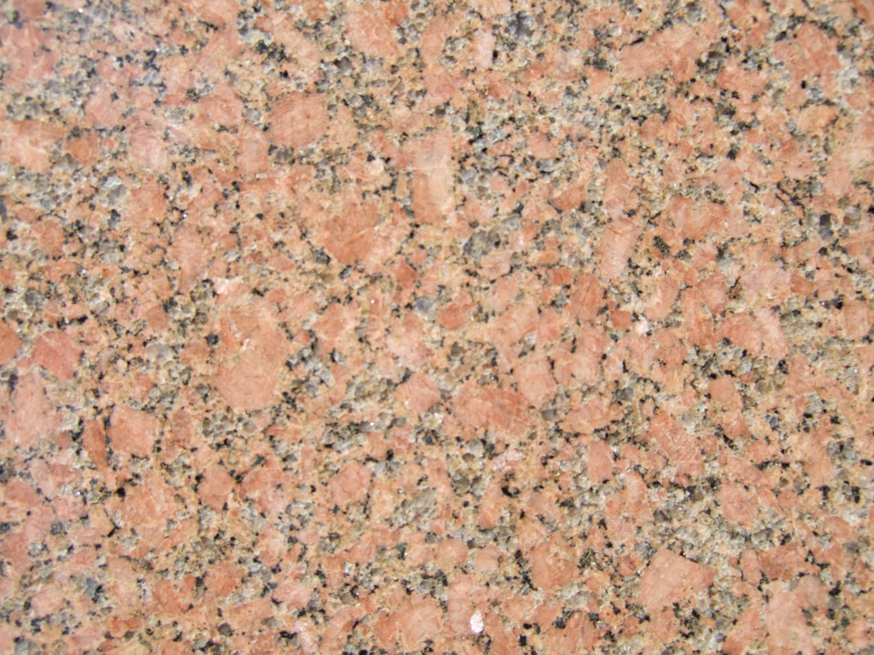
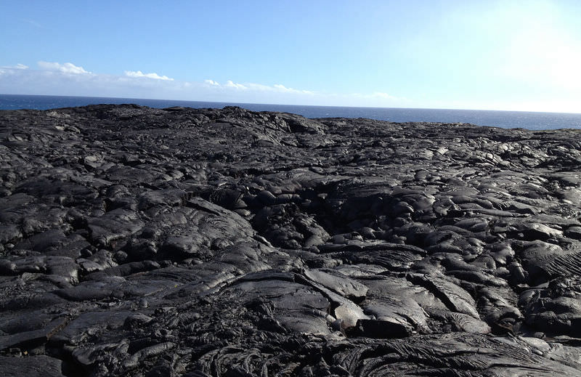
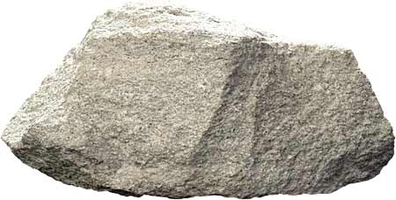
IGNEOUS ROCKS
Consist of solidified molten material
Molten material can include magma and lava
Different rocks can form based on how quickly the material cools
Pumice, Obsidian, Rhyolite are examples of quickly cooling rocks
Basalt and Granite cool slowly, many times while still underground
Sources: http://geologylearn.blogspot.com/2015/03/rhyolite.html
https://en.wikipedia.org/wiki/Granite
https://read.activelylearn.com/#teacher/reader/authoring/preview/534137/notes

Slide 5
METAMORPHIC ROCKS
Rocks that have been transformed by extreme heat and pressure
Both sedimentary and igneous rocks can turn into metamorphic rocks
The extreme pressure and heat found deep in the earth’s crust is what causes these rocks to change, or “metamorphose”
Source: https://www.sandatlas.org/schist/

Slide 6
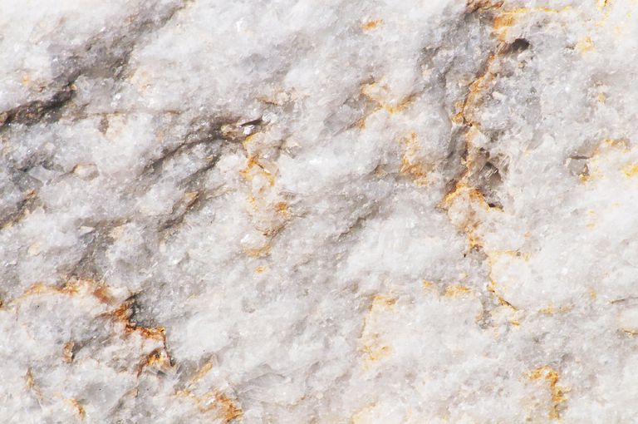
WHAT IS A MINERAL?
Naturally occurring, homogenous, inorganic solid substance with a definite chemical composition and crystalline structure
Combinations of different minerals create different rocks
Granite (Igneous)
Quartz
Feldspar
Mica
Hornblende
Sandstone (Sedimentary)
Quartz
Feldspar
Marble (Metamorphic)
Calcite
Mica
Quartz
Graphite
Source: https://www.thoughtco.com/marble-rock-geology-properties-4169367

Slide 7
MINERAL IDENTIFICATION
Over 3,000 types of minerals exist worldwide
How do we tell them apart?
Color
Luster
Hardness
Streak
Cleavage
Special Properties

Slide 8
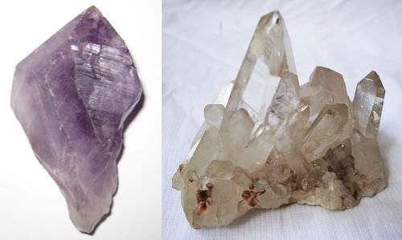
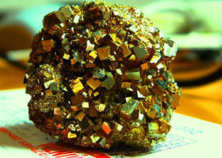
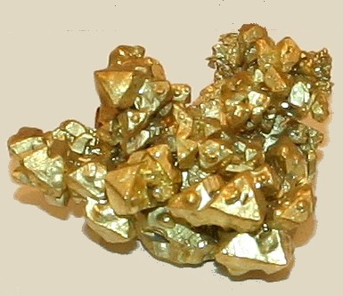
COLOR
Generally, the most obvious characteristic
The least reliable
Some different minerals can be the same color, and some minerals that are the same can have different colors!
For mineral identification we look at basic color
Light vs. dark
Purple Quartz or Amethyst (Left) is the same mineral as Clear Quartz (Right). The color is caused by a small iron impurity.
Pyrite or Fool’s Gold (Left) and real Gold (Right) have very similar color and appearance but are completely different minerals!
Source: https://courses.lumenlearning.com/geo/chapter/reading-physical-characteristics-of-minerals/

Slide 9
LUSTER
Luster: how the surface of a mineral reflects light
Whether a mineral has metallic luster or a nonmetallic luster
Metallic luster means the surface of the mineral is shiny like polished metal
Non-metallic luster refers to many other lusters
Most common is “Glassy” or with the appearance of a piece of glass
Others include pearly, greasy, silky, waxy, rusty, and dull
Source: http://nevada-outback-gems.com/mineral_information/gold_mineral_info.htm

Slide 10
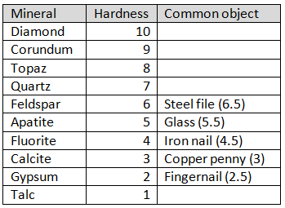
HARDNESS
Hardness: a mineral’s ability to resists its surface being scratched or punctured
Measured on a scale of 1-10 called the Moh’s Scale of Hardness
Any unknown minerals hardness can be determined
What the mineral scratches
What scratches the mineral

Slide 11
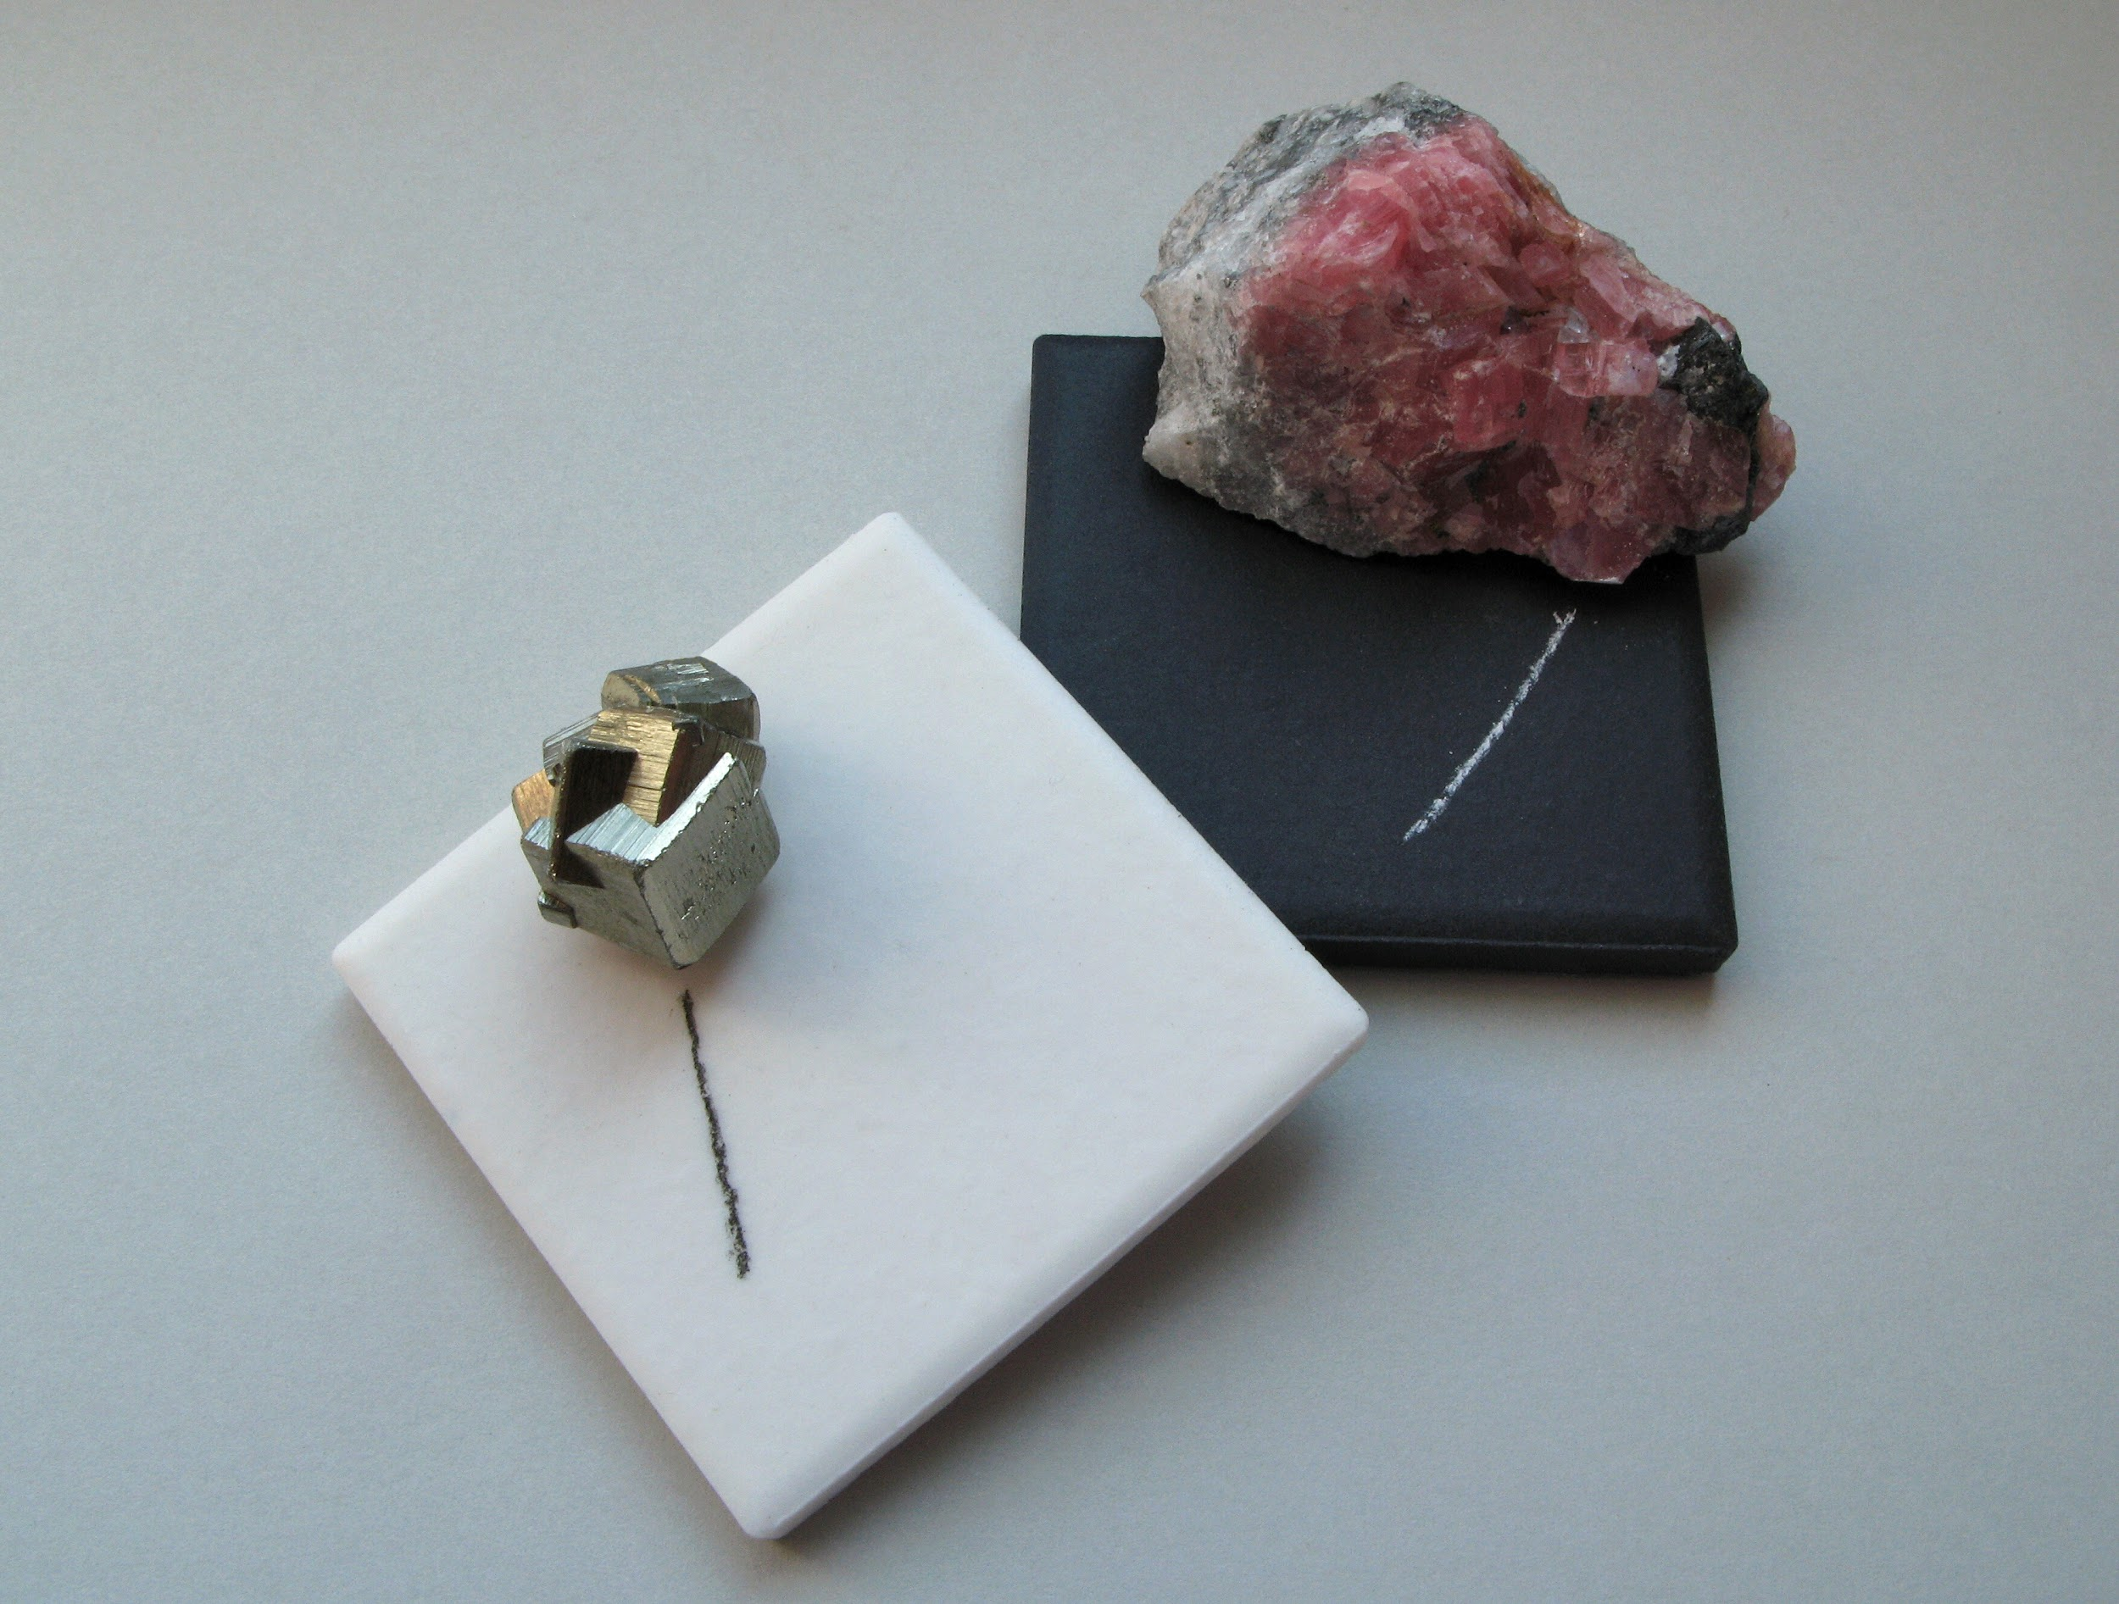
STREAK
Streak: refers to the color of a mineral’s powder
External color of a mineral varies, but streak will always be the same color
Makes it a more reliable identifier than color alone
Not all minerals have streaks
To check streak, a mineral is scraped across an unglazed porcelain tile
Some streaks are totally different in color to the appearance of the mineral
Source: https://en.wikipedia.org/wiki/Streak_(mineralogy)

Slide 12
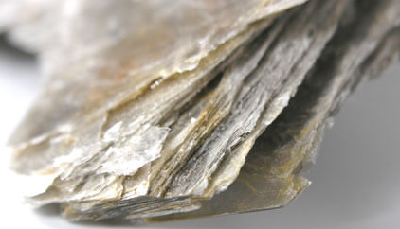
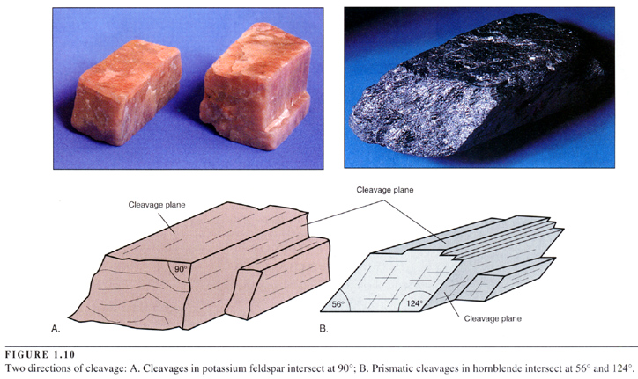
CLEAVAGE
Cleavage: refers to the tendency of a mineral to break along planes in its structure resulting in a smooth flat surface
Represents a plane of weakness within the crystal structure of a mineral
Described by the number of cleavage planes, as well as their angle of orientation to one another
Not all minerals have cleavage
Most easily observed by holding a mineral to the light and seeing how the light reflects off of its surfaces
A cleavage plane will appear smooth and shiny
Source: https://www3.nd.edu/~cneal/planetearth/Lab-Mineral-ID/Cleavage.html

Slide 13
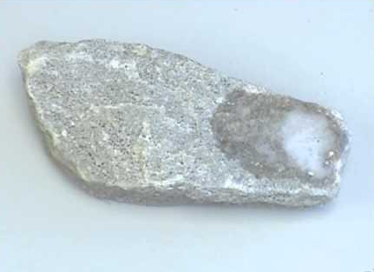
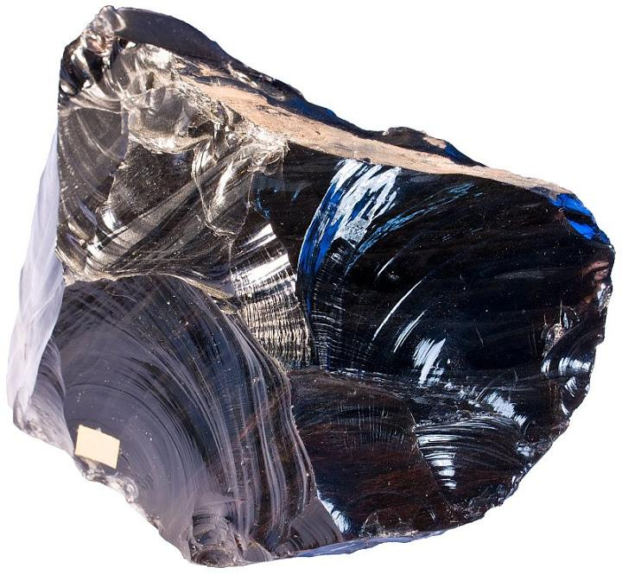
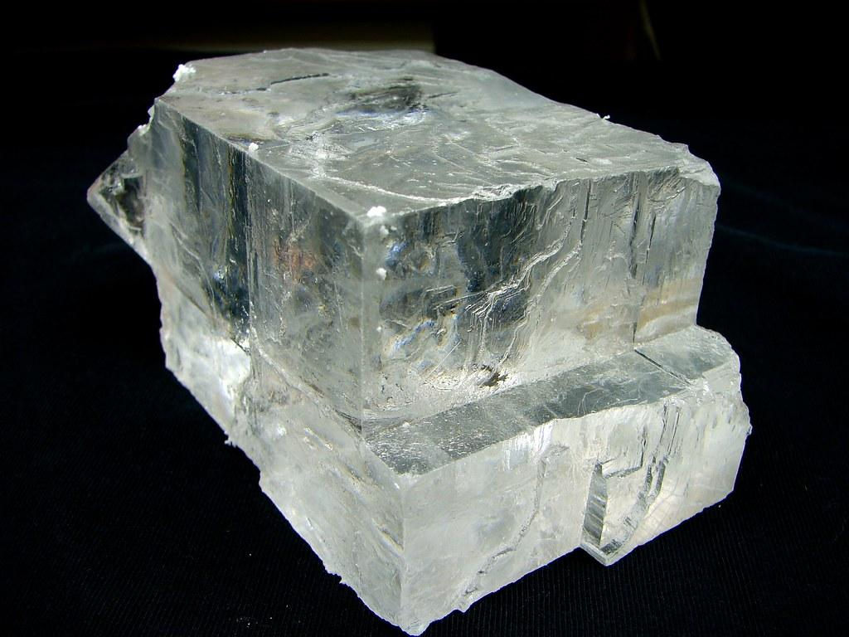
SPECIAL PROPERTIES
Some minerals have special properties and characteristics others do not possess
These properties include but are not limited to:
Magnetism
Elasticity (Flexibility)
Reaction to acid
Fractures
Odor
Taste
Sources: https://sternberg.fhsu.edu/geology-2/minerals/classification/
https://geology.com/minerals/acid-test.shtml
https://www.quantumuniverse.nl/ancient-minerals-as-neutrino-detectors

Slide 14
BROUGHT TO YOU BY…
THE REGIONAL SCIENCE
CONSORTIUM

Slide 15
LEARN MORE AT…
www.RegSciConsort.com
www.RegSciTV.com

