Slide 1
Native Americans in the Great Lakes Region and Presque Isle State Park
Regional Science Consortium

Slide 2
Introduction
The Iroquois Nation
“Iroquois” is a French variant on the term for “snake”
Originally, and currently, called the Haudenosaunee
Also known as the Haudenosaunee Confederacy
Their culture is dynamic and has changed over time
The Six Nations
Mohawk, Oneida, Cayuga, Seneca, Onondaga, and Tuscarora
Each has own language similar to all Haudenosaunee
Many traditional terminology provided through presentation in Seneca Nation pronunciation

Slide 3
The Six Nations
MOHAWK (MO-hawk) or Kanien’kehaka
“People of the Flint.”
“Keepers of the Eastern Door” since they are the easternmost nation in Haudenosaunee territory.
Responsible for protecting and defending the eastern boundaries of Haudenosaunee territory.

Slide 4
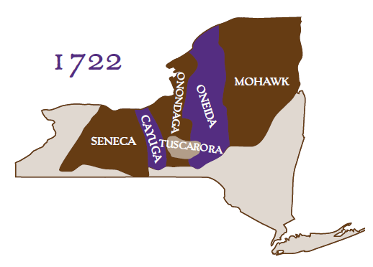
The Six Nations
ONEIDA (o-NY-da) or Onayotekaono
“People of the Standing Stone.”

Slide 5
The Six Nations
ONONDAGA (on-nen-DA-ga) or Onundagaono
“People of the Hills.”
Also called “Keepers of the Central Fire” since the Onondaga Nation is considered the capital of the Confederacy.

Slide 6
The Six Nations
CAYUGA (ka-YOO-ga ) or Guyohkohnyoh
“People of the Great Swamp.”

Slide 7
The Six Nations
SENECA (SEN-i-ka), or Onondowahgah
“People of the Great Hill”
Also known as “Keepers of the Western Door” because they are the westernmost nation in Haudenosaunee territory.
They were responsible for protecting and defending the western boundaries of Haudenosaunee territory.

Slide 8
The Six Nations
TUSCARORA (tus-ka-ROR-a) or Skaruhreh
“The Shirt Wearing People”
In 1722, members of the Tuscarora Nation, who were living in what is now North Carolina, traveled north to seek refuge among the Haudenosaunee.
They were invited to join the Haudenosaunee Confederacy, becoming its sixth nation.
Since that time, the Confederacy has also been known as the Six Nations.

Slide 9
Ongweh’onweh (ongk-way-HON-way)
The Haudenosaunee define themselves as the Ongweh’onweh (ongk-way-HON-way) or “real human being”
Although many cultural similarities and family connections unite the six nations, each one is also unique and has its own distinct language.
Haudenosaunee Flag

Slide 10
Haudenosaunee Clan System
Each of the six nations of Haudenosaunee is comprised of extended family groups called CLANS. A CLAN MOTHER heads each clan.
In the past, a clan mother was usually the oldest woman of the clan.
Today, clan mothers are chosen for their cultural wisdom and dedication to the Haudenosaunee people.
Clan mothers have been given the honor of their duties because of a woman who lived long ago called the Mother of Nations.
Clans are extended families. Haudenosaunee clans are MATRILINEAL. This means they follow the line of descent of the mother. Children belong to their mother’s clan.
The clan mother has an important role. Some of her responsibilities are to:
Make all the major decisions that affect the clan.
Assign names to people in her clan.
Nominate the male leader of the clan. The male leader is called the HOYANEH meaning “Caretaker of the Peace”
Help ensure that all members of her clan are fed.

Slide 11
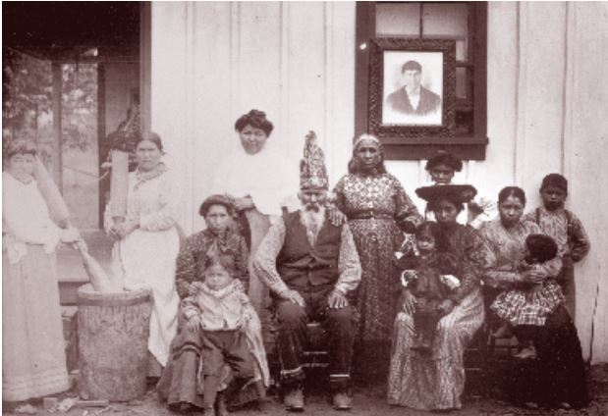
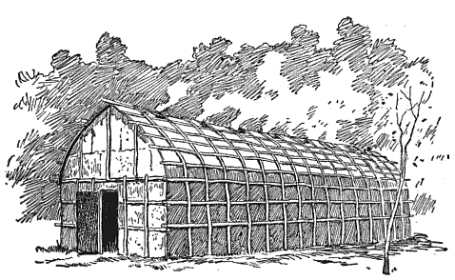
Oneida Family Portrait
Ontario
The Oneida family pictured on a Canadian reserve in 1907.
Traditional Longhouse Sketch
Longhouses were traditional homes of the Haudenosaunee. They are long, narrow, single room buildings. As many as five families would share longhouses made from timber and thatching.

Slide 12
Thanksgiving Address Gano:nyok (ga-NYO-nyok)
The Haudenosaunee give thanks daily, not just once a year. They give thanks for all things, from the water and sun to the insects and animals.
The Gano:nyok serves as a reminder to appreciate and acknowledge all things. The words express thanks for fellow human beings, Mother Earth, the moon, stars, sun, water, air, winds, animals, and more.

Slide 13
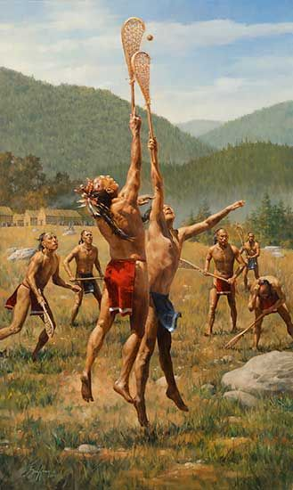
Lacrosse Tewaarathon
Today, lacrosse is an international team sport played competitively all over the world. This modern game originated with the Haudenosaunee.
Four hundred years ago, explorers to Haudenosaunee territory saw the game of lacrosse being played.
The French Jesuits called the game “la crosse” because it was played with a long stick, which they called a crosse.
Among the Haudenosaunee the game is called Tewaarathon, which means “they bump hips.”

Slide 14
Native American and European Timeline
Below is a brief timeline of important Native American and European interactions
The Beaver Wars | The Five-Year War | French Settlement of Erie | Seven Years’ War | American Revolutionary War | The Sullivan Expedition
1650-1700 | 1653-1658 | 1753 | 1756-1763 | 1775-1783 | 1779-1780
War between Native American Nations over hunting and trapping territory | War between the Erielhonan and the Haudenosaunee | Building of Fort Presque-isle to prevent encroaching English forces | Struggle for global primacy between Britain and France; British forces occupy Fort Presque-isle | American forces pitted against British Loyalist; Native American nations choose sides | Cherry Valley and Wyoming Massacres were won by Haudenosaunee and British Loyalists; Gen. George Washington launched massive retaliation

Slide 15
Erielhonan (The Erie People)
Were a Native American people historically living on the south shore of Lake Erie.
A Haudenosaunee group, they lived in what is now western New York, northwestern Pennsylvania, and northern Ohio before 1658
Accepting members of Huron Nation after they were decimated by the Haudenosaunee
Beginning in 1653 the Erie launched a preemptive attack on western tribes of the Haudenosaunee
Did well in the first year of a five-year war
In following years, their villages were burned as a lesson to those who dared oppose the Haudenosaunee

Slide 16
The End of the Erielhonan
Haudenosaunee warred against Erie and neighboring tribes of The Neutrals and The Tobacco People in 1654
By the mid-1650s, the Erie had become a broken tribe.
Dispersed groups survived a few more decades before being absorbed into the Haudenosaunee, especially the westernmost Seneca nation
Descendants?
Anthropologist Marvin T. Smith theorized that some Erie fled to Virginia, where they were known as Rechahecrian and then South Carolina, where they became known as the Westo.
Some were said to flee to Canada.
Members of other tribes claimed later to be descended from refugees of this defunct culture, who intermarried with other peoples. Among those are members of the Seneca people in Oklahoma and Kansas

Slide 17
A Mysterious People
Because the Erie were located further from the coastal areas of early European exploration, they had little direct contact with Europeans.
Jesuit missionaries in Canada referred to them in historic records after learning more about them during the Beaver Wars
What little is known about them has been derived from oral history of other Native American tribes, archaeology, and comparisons with other Haudenosaunee peoples

Slide 18
The Sullivan Expedition
An extended systematic military campaign conducted by the United States during the American Revolutionary War against Loyalists and the Six Nations of the Haudenosaunee which had sided with the British.
It has been described by some historians as a genocide due to the magnitude and totality of its violence towards and destruction of the Haudenosaunee.
Destroyed more than 40 Haudenosaunee villages and stores of winter crops, breaking the power of the six nations in New York all the way to the Great Lakes.

Slide 19
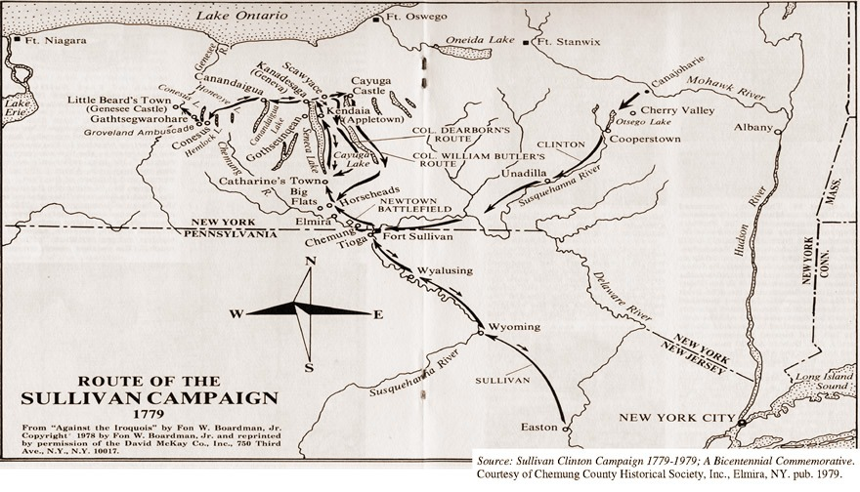
Orders of George Washington to General John Sullivan, at Head-Quarters (May 31, 1779)
“The Expedition you are appointed to command is to be directed against the hostile tribes of the Six Nations of Indians, with their associates and adherents. The immediate objects are the total destruction and devastation of their settlements, and the capture of as many prisoners of every age and sex as possible. It will be essential to ruin their crops now in the ground and prevent their planting more.”

Slide 20
The Erie Triangle Dispute
Present day Erie would have been situated in a disputed triangle of land that was claimed by the states of New York, Pennsylvania, and Massachusetts.
The Six Nations of the Haudenosaunee released the land to Pennsylvania in January 1789 for payments of $2,000 from Pennsylvania and $1,200 from the federal government.
The Seneca Nation separately settled land claims against Pennsylvania in February 1791 for the sum of $800
Officially became part of Pennsylvania on 3 March 1792, after Connecticut, Massachusetts, and New York released their claims to the federal government
Sold the land to Pennsylvania for $151,600 in Continental certificates.

Slide 21
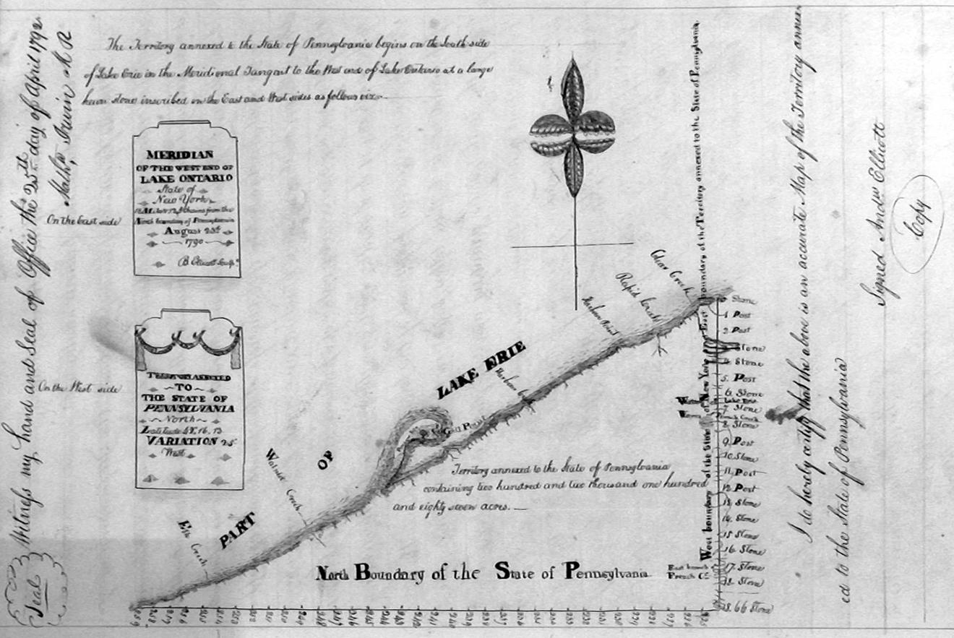
The Erie Triangle is located at an advantageous trading position. This map was created after the triangle became Pennsylvanian land by the famous land surveyor Andrew Ellicott.

Slide 22
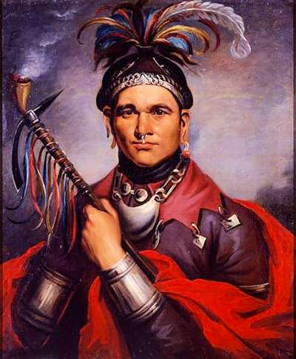
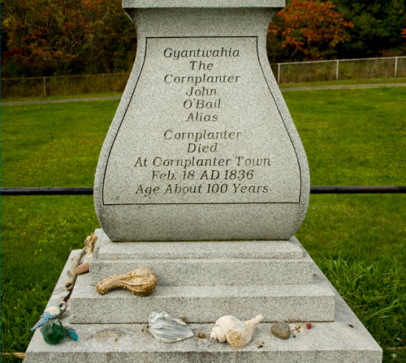
The Story of Cornplanter, Seneca Chief (Gyantwahia)
His mother was of the Seneca Nation and his father a Dutch trader
Became a leader in the Seneca Nation
Believed in maintaining neutrality during American Revolution, but when Haudenosaunee voted to side with British Loyalists, he became a prominent War Chief
Helped win Cherry Hill and Wyoming Massacres
Gen. Washington decimated Haudenosaunee in response with the Sullivan Expedition
Became negotiator between US government and Haudenosaunee
Was awarded a land grant in Warren County near the Allegheny River for his negotiations
Abolished Quaker ways after treatment of Native people became too grotesque
Disputed sale of Erie Triangle
Buried on his land; remains and monument moved to higher ground when Kinzua Dam was built

Slide 23
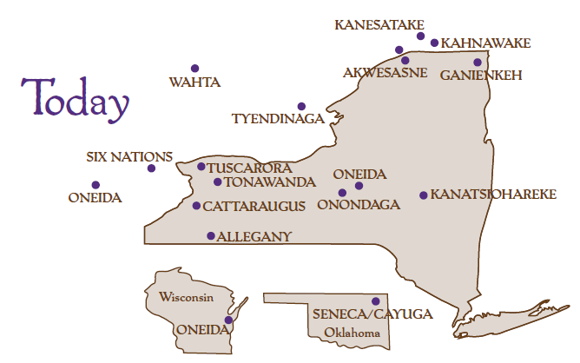
Where are the Haudenosaunee Today?
Traditional culture changed forever by European contact
Ways of obtaining food and clothing have changed, but maintain rich ceremonial and community life
Have been able to live and thrive as a unified people on territories, reservations, and reserves in upstate New York, Wisconsin, Oklahoma, North Carolina, Ontario, and Quebec
Native lands hold cultural and religious significance for Native people
Approximately two-thirds of Native people in the United States lived off reservation lands in rural areas, towns, and cities

Slide 24
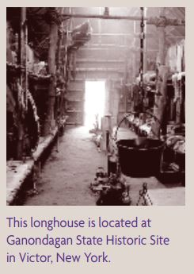
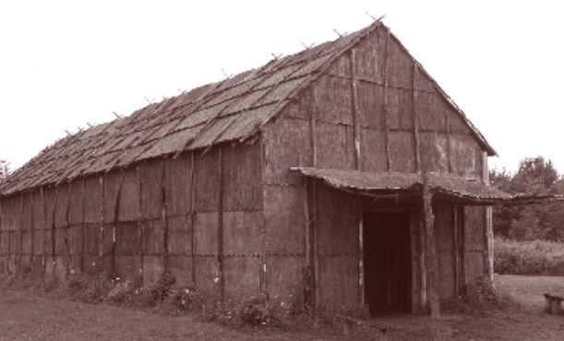
Historical Cultural Sites and Artifacts

Slide 25
Historical Cultural Sites and Artifacts
Net sinkers or “sinker-stones” found on Presque Isle in 1936-1938 along a beach known as “Hidden Beach”
¼ mile west of waterworks ponds
Nets made from animal tissues and vegetal fibers have long since degraded
Finding shows evidence of Erielhonan and/or Haudenosaunee located in Erie, PA and on Presque Isle
Erie, Penna. Illustrated, 1888 states:
“part of a war-like tribe of Seneca lived at the head of PIB; they were the last of the “children of the forest” remaining on the lake shore in the vicinity of Erie”

Slide 26
Conclusion
“We gather our minds to greet and thank the enlightened Teachers who have come to help throughout the ages. When we forget how to live in harmony, they remind us of the way we were instructed to live as people. With one mind, we send greetings and thanks to these caring Teachers. Now our minds are one."
~From the Haudenosaunee Thanksgiving Address

Slide 27
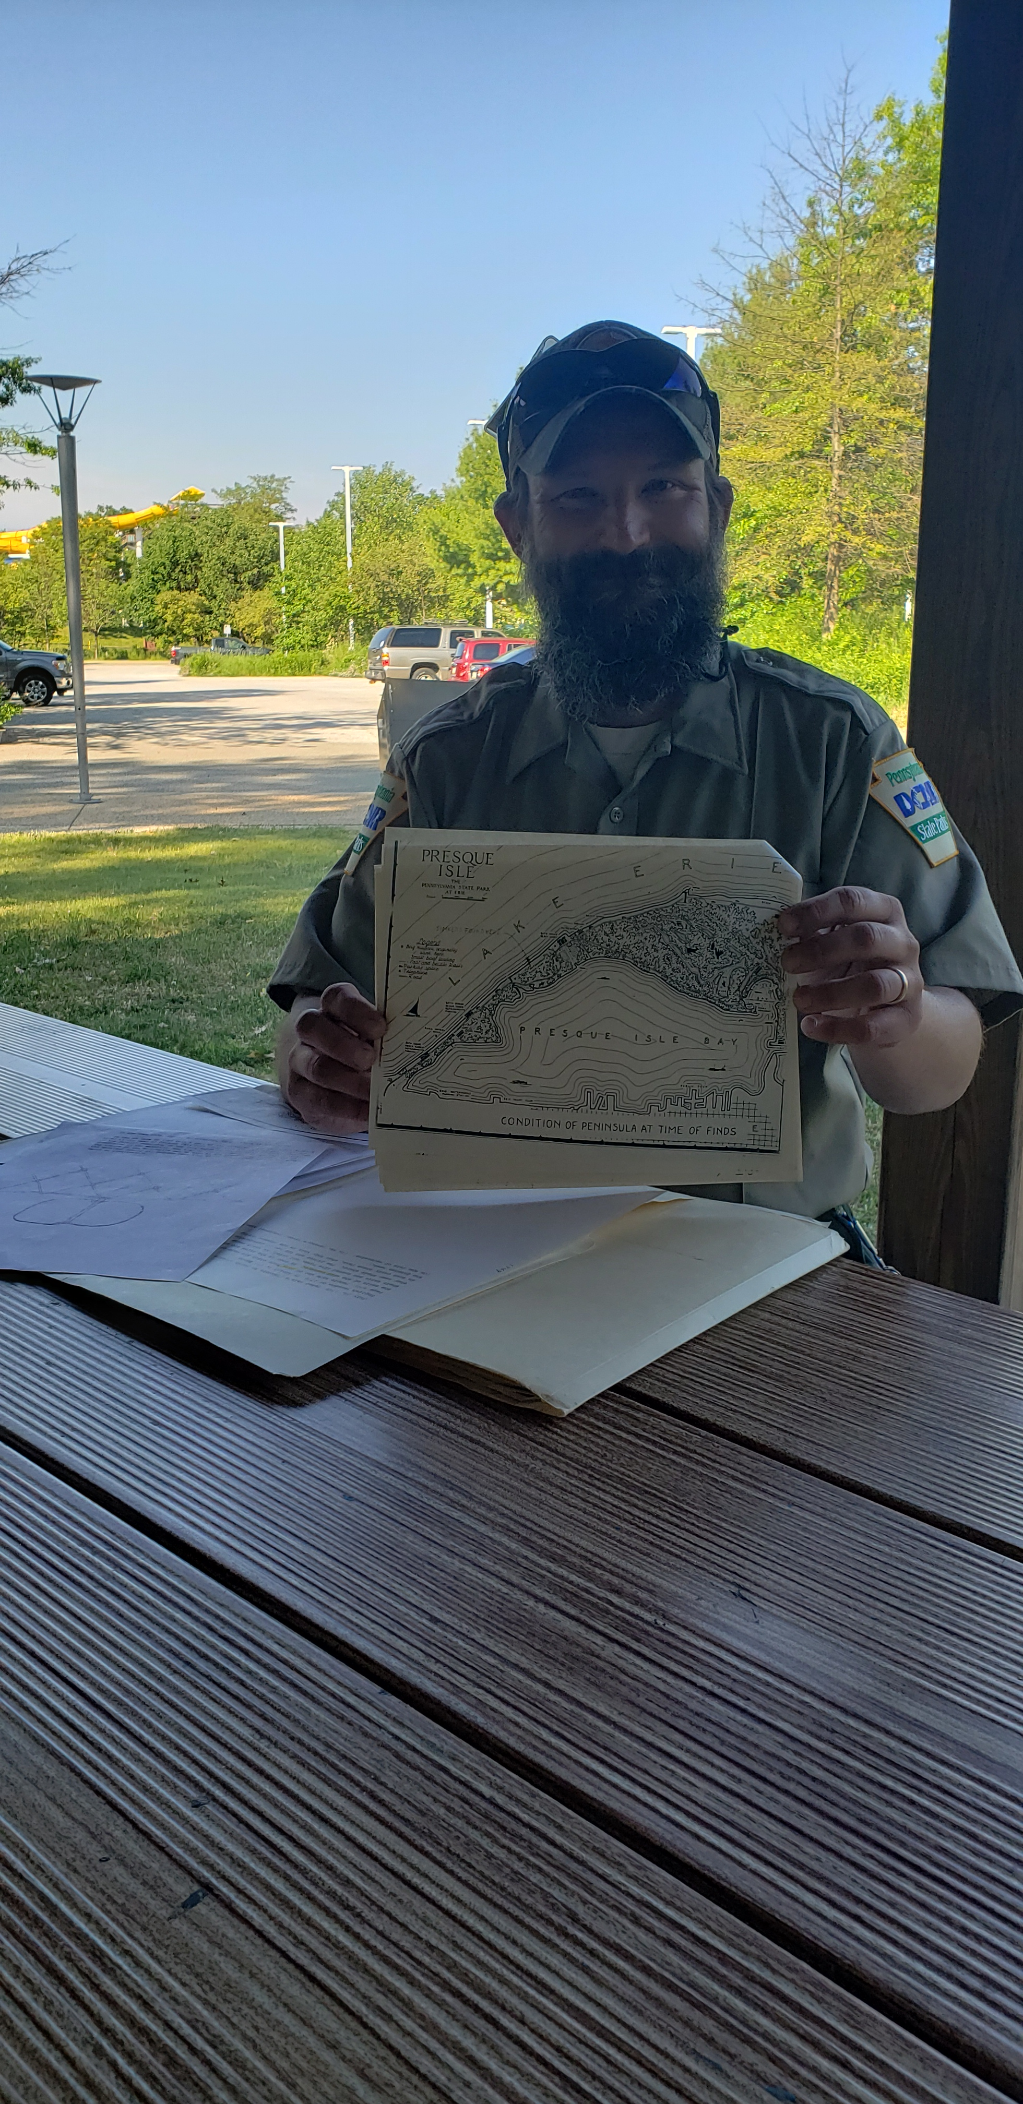
Researchers
Amber Stilwell
Research Coordinator
Regional Science Consortium
Brian Gula
Environmental Educator
Department of Conservation of Natural Resources

Slide 28
Resources:
Haudenosaunee Guide for Educators
Cornplanter Cemetery, Warren, PA
Cornplanter, Seneca War Chief
Iroquois Longhouses
Early Localization of Native Americans in NY
The Native Erie People
Ohio History Central: Beaver Wars
Wampum Chronicles
Pre Colonian Americas: Erielhonan
Iroquois Confederacy Flag
The Iroquois Confederacy
Erie, Penna. Illustrated, 1888
DCNR Catalogs
Seven Years War
Ohio History Central: Iroquois Native Americans
Ohio History Central: Lake Erie History
Sullivan Expedition
Pennsylvania Heritage: Geography Shapes History
Erie Yesterday: Settlement of the Erie Triangle
Erie Reader: The Story of the Erie Triangle
Native Americans and the Great Lakes
Great Lakes Native Peoples
Milwaukee Public Library: Great Lakes Tribes

